Slide 1

Vacherin Monthly H&S Meeting
July 2025

Slide 2



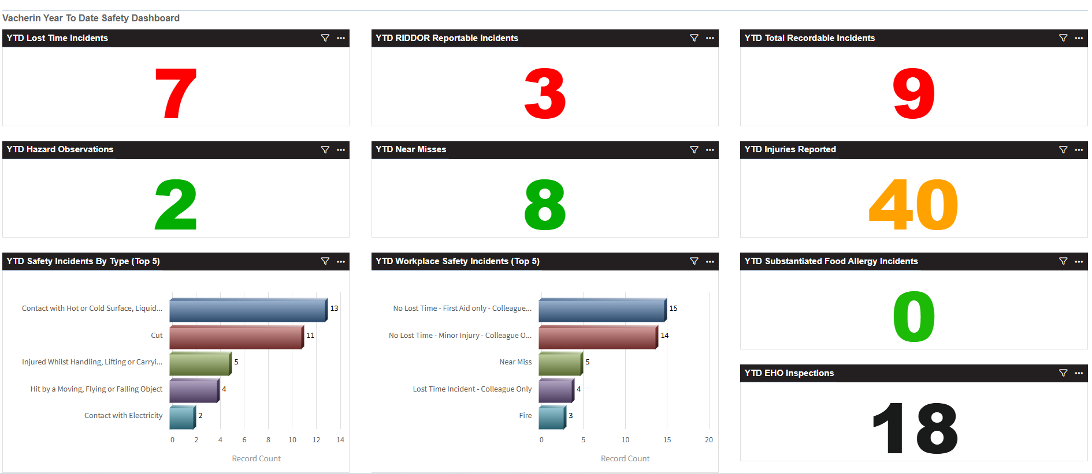
Vacherin Year to date stats

Slide 3






Vacherin June incidents summary
1 x Injury from moving furniture
(remind staff to not carry/move heavy furniture alone)
2 x Electric shock from the same Thermomix, on two different occasions
(despite equipment and sockets being checked after first instance – requested that the item was disposed of)
5 x Cut injuries:
2 minor from chopping herbs & chopping chillis (distraction/lapse of concentration)
2 x from cutting whilst holding foods in their hand; 1 minor from cutting watermelon 1 RIDDOR from cutting the stone out of an avocado
1 x from broken glass whilst handwashing
3 x burn incidents (burnt on oil that came out of a spring roll, hand touched hotlight, burn removing a pan from under a salamander
Equipment such as salamanders are typically high level, above eyeline - control ensure anything under salamander
doesn’t contain liquid / excessive oil)
3 injury (Thermomix stored on a high shelf, part of it fell on team member when getting it down, trip over dishwasher door that was lowered, walking too fast and hit foot on fridge) (Ensure equipment is stored on a shelf at eye level or below)
1 Fire – pan caught alight after being turned on where chef was called to another task (distraction/lapse of concentration)
0 near miss reported in June

Slide 4


Vacherin June incidents summary
1 x reported EHO visit for June 5 (FHR 5 received - a re-visit following a FHR 2 due to pest activity throughout the building, including the catering areas)
4 x Foreign body incidents
IP broke a tooth on what they believed to be a raspberry seed from a cookie
(unsubstantiated as they could not prove this)
Fragment of broken crockery in meal which cut IP’s tongue
(substantiated – Ensure breakages are recorded)
Plastic in food – believed to be pen
(Food came from the Central Production Unit who are switching to factory issue pens to eliminate use of biros)
Moth in food (unsubstantiated – area where salad is served is open, uncovered)
Plastic from a storage container in food (substantiated as did appear to come from a container)
2 x Alleged food poisoning incidents
(Both unsubstantiated, from 70 portions of a hot main dish produced and sold only 1 complaint of nausea (no other food poisoning symptoms). One from a tuna sandwich.
1 x Allergy Incident – team member was unable to find the product a customer was enquiring about on the allergen matrix (it was there, human error, but was also available on the customer facing menu)

Slide 5



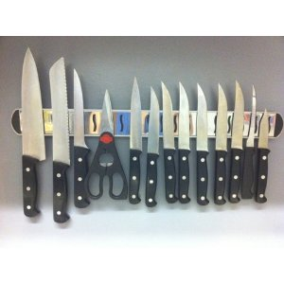
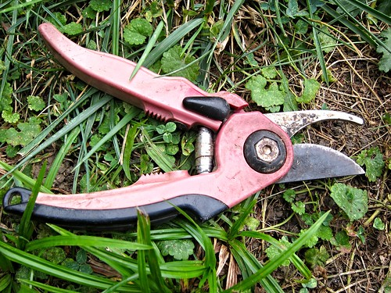
July See Care Share
In focus:
Ice and ice machines
Hygienic storage of bagged ice
Hygienic storage of the scoop for an ice machine
The Ice Machine Cleaning Schedule
Knife Safety
Safe knife storage
Checks for damage / blunt blades
Garden safety tips at home
Double click image for the PDF
This Photo by Unknown Author is licensed under CC BY
This Photo by Unknown Author is licensed under CC BY-NC

Slide 6
Knife safety
Ice safety
Double click images for the PDFs

Slide 7
Cut gloves
Compass encourage the use of cut gloves when using sharp knives
CH&CO are not exempt from this
You are likely to have received some in the mobilisation packs at integration
Sites which report H&S cut incidents from knife use will be reminded they should be used
Useful training resources for cut gloves
Preventing cut injuries PDF
https://www.mycompasshse.co.uk/sector-hse/chartwells-hse/videos/
Double click image for the PDF

Slide 8
Useful cut glove resources
Double click images for the PDFs

Slide 9
HSE Updates
Recent Safety Task Cards
STCCS100 Server Robots (New)
Safety Awareness 101 Posters
Awareness poster - Preventing Foreign Bodies
Awareness poster - Using Trolleys
Recently updated Hazard Analysis Posters
Available on the HSE website
Hospitality or Counter Service
Or can be ordered from Linney

Slide 10
HSE Updates
Disposal of animal milk
Businesses should not dispose of animal milk via a sink or external drain
It is classed as a lower risk animal by-product and can cause decreased oxygen levels in water courses affecting fish/other creatures
Double click image for the PDF
Sites will be largely unaffected as unfinished tea/coffees containing milk, and drinks such as milkshakes can be poured down the sink in single serve quantities
If you have surplus milk, pour it into one container and dispose of that in the bin
Recycle the empty container(s)
If you routinely need to dispose of large quantities of milk you must immediately adjust your order quantities

Slide 11


HSE Reminders
Training for Supervisors/Deputies/Sous Chefs
Ensure the team members who are responsible in the Manager and Head Chef’s absence have completed the correct online training
Food Safety Level 3

Slide 12

HSE Reminders
Near Miss / Hazard Observation reporting
Please reiterate with the team that if they do see a Near Miss or a Hazard Observation it should be reported
Between 02.07.25 and 10.07.25
Please display the poster for reporting on your staff notice board if you haven’t already

Slide 13
HSE Reminders
Upload copy of allergen risk assessment to Air3
As of 10th July, 47 Vacherin sites had uploaded their allergen risk assessment to Air3. If you have not done this already, please do so.
Use this link to access the area of Air3 where the allergen risk assessments need to be uploaded
See instructions on PDF
Double click image for the PDF

Slide 14
HSE Reminders
Closing actions on Air3 from audits and site visits
As of 10th July the following sites were showing as having open actions from an audit, site visit or mobilisation
23 Saville Row | Cooley LLP | L&G Hove | The Met Building
Ashurst LFWE | Egon Zehnder | Lantern | Woburn House
Axa - Bishopgate | EY 1 Colmore Square | LMA Stratford | XL Catlin Services SE Rest
BBC Elstree | EY 25 Churchill Place Retail | Miller Insurance Services
BCLP | Foster & Partners Sterling Hse | Mishcon de Reya
BDO 55 Baker Street | Foster & Partners The Bar | Moody's
BDP Hospitality | Foster & Partners The Hub | National Audit Office
Boden | Foster & Partners The Pantry | Ortus
Bond Dickinson – Briston | Harbottle & Lewis | Peel Hunt
Bond Dickinson – London | L & G Coleman Street | Squire Patton Boggs

Slide 15
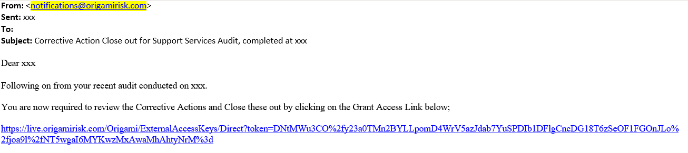
HSE Reminders
Audit reports / site visit reports are sent out directly from the system
The emails come from notifications@origamirisk.com
They are sent to the unit manager email address provided at the time of the visit
At the point reports are sent, managers will receive a separate email from notifications@origamirisk.com with a Grant Access Link
The Grant Access Link lets you into the audit to close off actions

Slide 16
HSE Reminders
Search the manager’s inbox (and junk mail) for emails from notifications@origamirisk.com, or search for the term 'Grant Access Link’
The Grant Access Links are time sensitive, so do expire
If the link has expired email hse@compass-group.co.uk
- Quote the audit number, which can be found at the top of each report
- If there have been staff changes within the team since the audit check it is being emailed to the correct email address

Slide 17
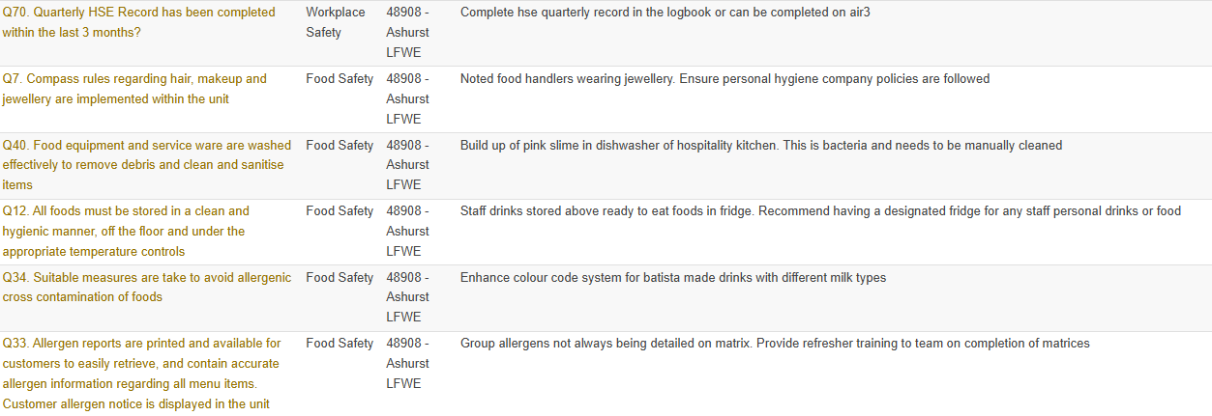
HSE Reminders
The questions with actions will be displayed on screen
Click on the question

Slide 18
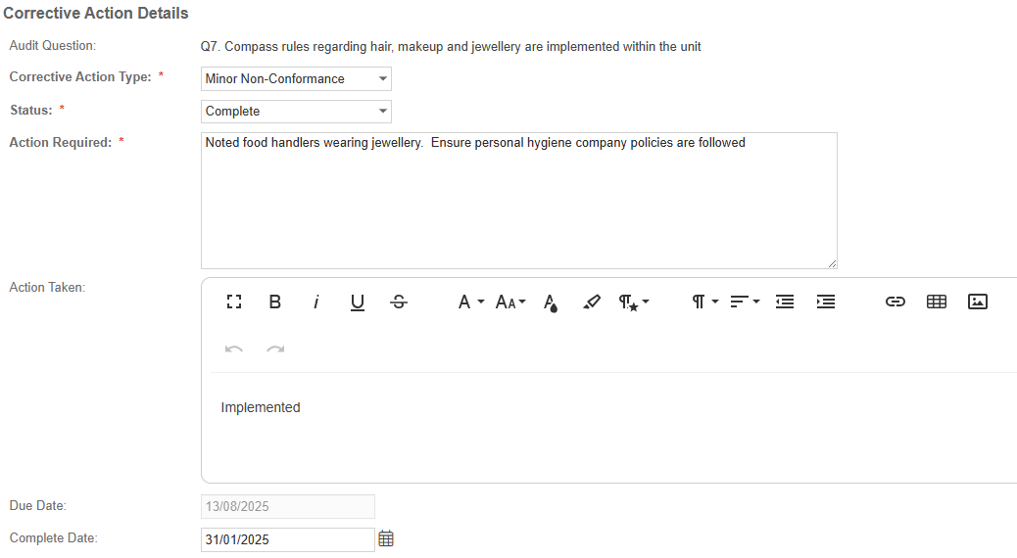
HSE Reminders
A box will pop up
Change the status from ‘New’ or ‘Assigned’
to
‘Complete’ or
‘In Progress’
Add a comment / details of what action
has been taken
Input the date completed

Slide 19



HSE Reminders
Add images if you wish
Add files and attachments if you wish
Click save in the top right-hand corner!

Slide 20
Q&A
Any questions?

