Slide 1



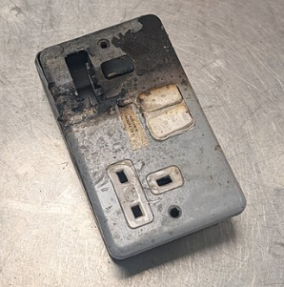
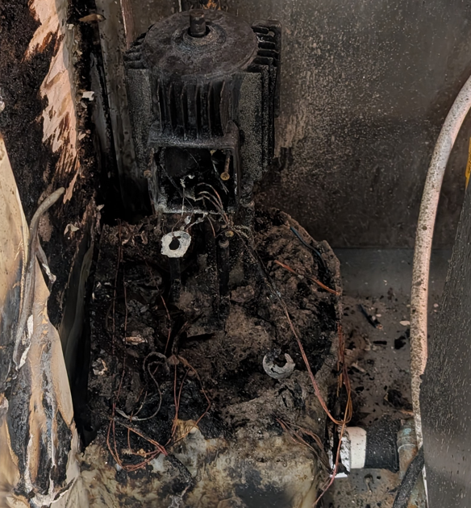

Lesson Learnt: Fires in June 2025
Actions Taken / Recommended
Action 1: staff refresher training on My Learning, search ‘Fire Safety’ for the e-learning course
Action 2: Review the relevant safety task cards, which may include:
STCCS 03 Combination and Steam Ovens
STCCS04 Cooking Ranges
STCCS 51 Barbeques
STCCS80 Unattended Use of Ovens
Add any additional controls identified to help prevent a possible reoccurrence to the Safety Task Cards
Action 3: Carry out refresher training with staff and document this on their Workplace Safety Training Record Cards
Action 4: Staff refresher training on checking equipment and surroundings before use
Action 5: Use staff-facing warning or precautionary notices/signage on equipment where required
Action 6: Review maintenance checks on equipment, PAT testing, hard wiring and electrical safety are up to date (check with the client where client managed)
Action 7; review fire risk assessment
Action 8: Raise awareness with the wider team on Hot Oil Safety with use of the Hot Oil Quiz
In Focus 🔍There have been 4 fires during the month of June in CH&Co unit A frying pan with oil was left on the hob unattended and caught fire. When the chef returned the pan was on fire and a fire blanket was used to out the fire out. A BBQ was being used to cook burgers and hot fat splashed onto a wooden surface nearby which caught fire. A member of staff called for help and a fire extinguisher was used to put the fire out An oven was plugged in overnight and caught fire. The alarm was raised, and fire service attended the scene A double tank fire was switched on but the chef who did this did not realise one side did not contain any oil and this caught fire. The chef on duty called to security for help who used a fire blanket to put the fire out Risk Assessment Potential Hazards:​ Burns and injury​ Death​ Smoke inhalation​ Damage to property​ Damage to equipment​ Risk Levels:​ Medium and High risk ​ Consequences of Getting it Wrong:​ Widespread fire causing damage to structure, buildings, equipment and reputation Injury, burns or death to CH&CO employees, agency workers, client staff, children, members of the public | Root Cause / Contributing Factors Human error Loss of concentration Distraction Poor communication Lack of checks Faulty wiring Not following procedures and processes Lack of training and knowledge
Preventative Measures / Best Practices
See Care Share safety conversations taking place each month keeping the team up to date on all information and update
Planned preventative Maintenance in place on all equipment
Do not leave cooking equipment unattended
📣 Whistleblowing 📣
Worried about how things are being run at work? Call the Whistleblowing Hotline 0808 801 0351 (UK) 1800 910 351 (IRL)
Or email: assistance@hospitalityaction.org.uk

