Slide 1

Vacherin Monthly H&S Meeting
January

Slide 2


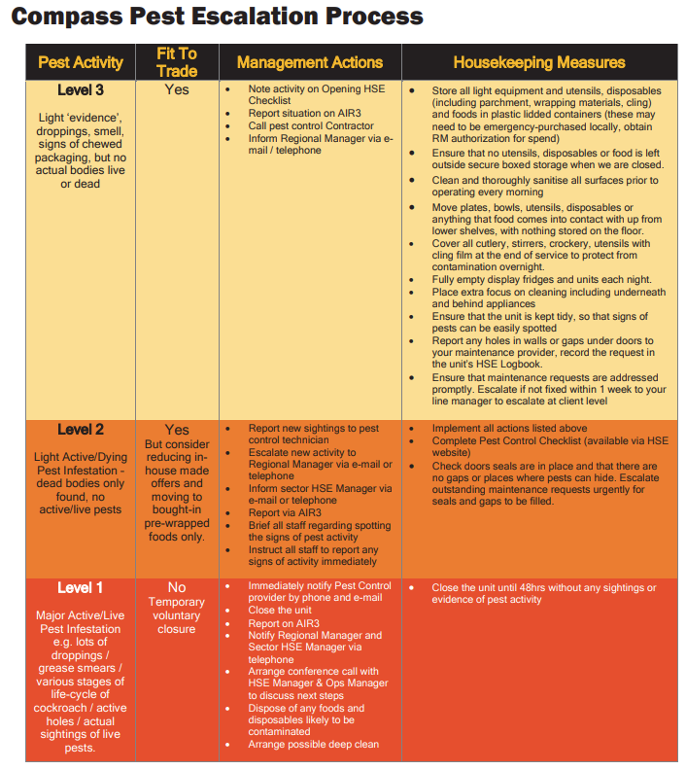

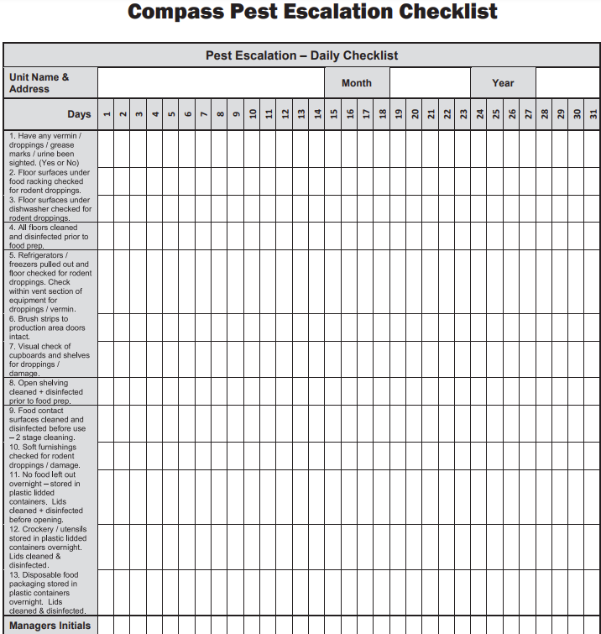
Pests!
Post Christmas is the busiest time of year for pest activity
Use the Compass pest control escalation process
Know the signs:
Droppings, smear marks, gnawed packaging, smell

Slide 3
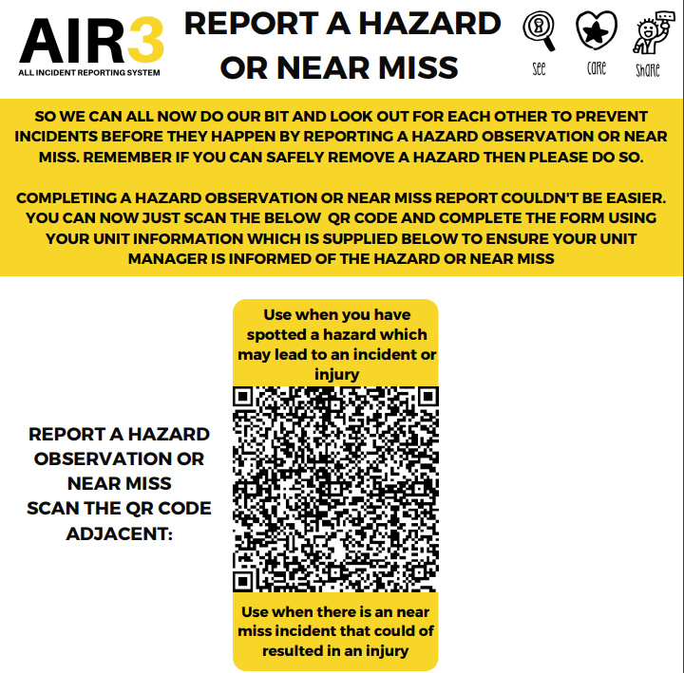
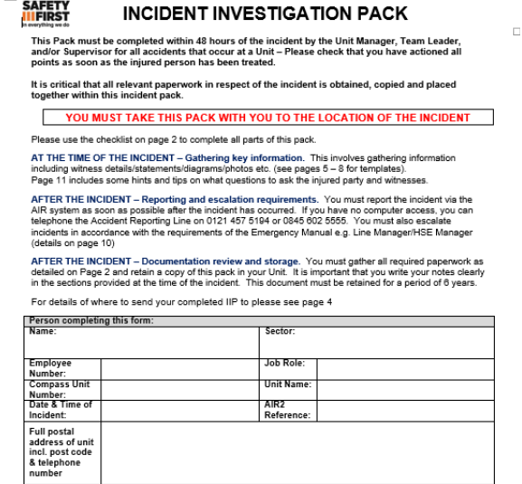
Accidents & Near Miss Reporting
Reporting near miss incidents may prevent future accidents occurring, resulting in injury
10 reported by Vacherin in 2024
https://www.mycompasshse.co.uk/media/ruoltnxz/5938report-a-hazard-or-near-miss-on-air3-with-qr-codepdf.pdf
Incident Investigation Packs for injury incidents

Slide 4
Specialist Foods (High risk processes)
https://www.mycompasshse.co.uk/food-safety/specialist-foods/
Contact HSE team
State the process you would like to add to the FSMS
Names of executive or head chefs
Evidence of food safety level 3 training

Slide 5
Audit structure
Food service audit from HSE team
Support visits (pests, incident investigations)
Ops. audits
EHO visits

Slide 6
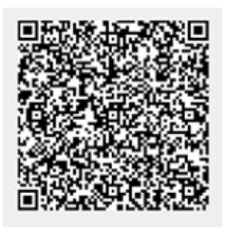
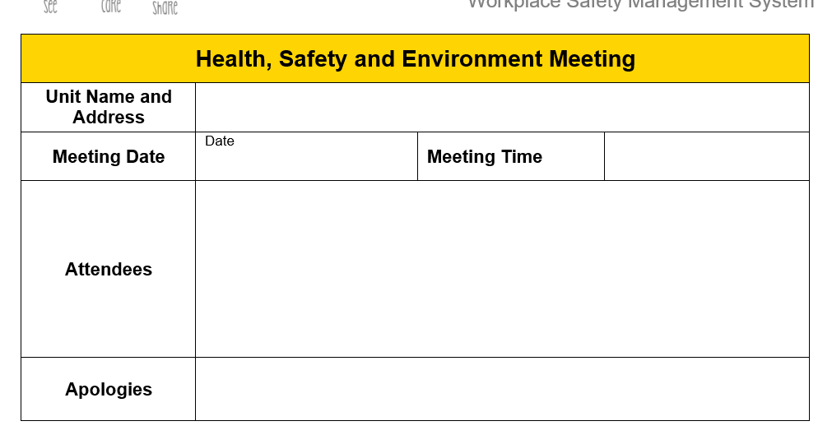
Internal audits
HSE quarterly record in HACCP log book OR on Air3
https://www.mycompasshse.co.uk/compliance/continuous-improvement/
HSE meeting minutes

Slide 7
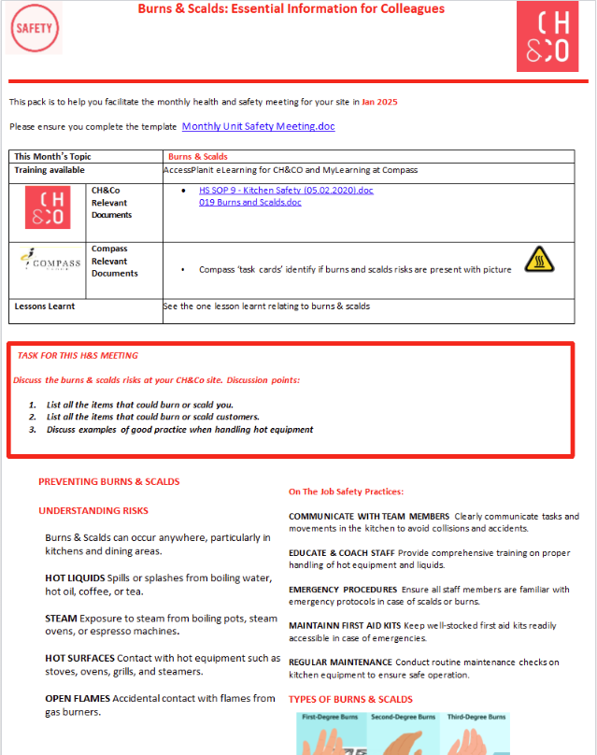
H&S meeting packs
To be used as part of monthly meeting agenda
January 2025 topic: Burns & Scalds
https://chco.sharepoint.com/sites/CHCOHSE/Shared%20Documents/H%26S%20Monthly%20Support%20Packs?csf=1&web=1&e=qfgKjo

Slide 8
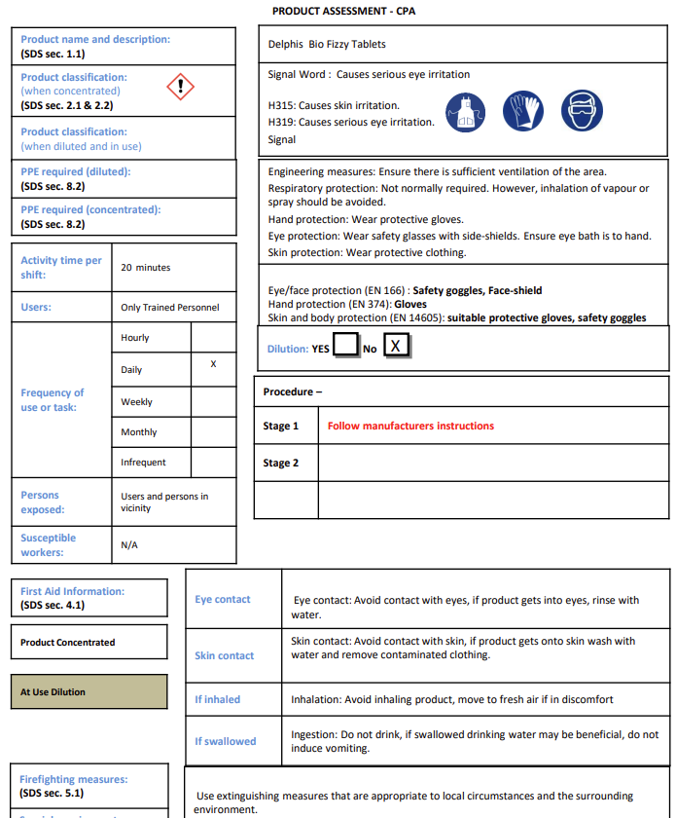
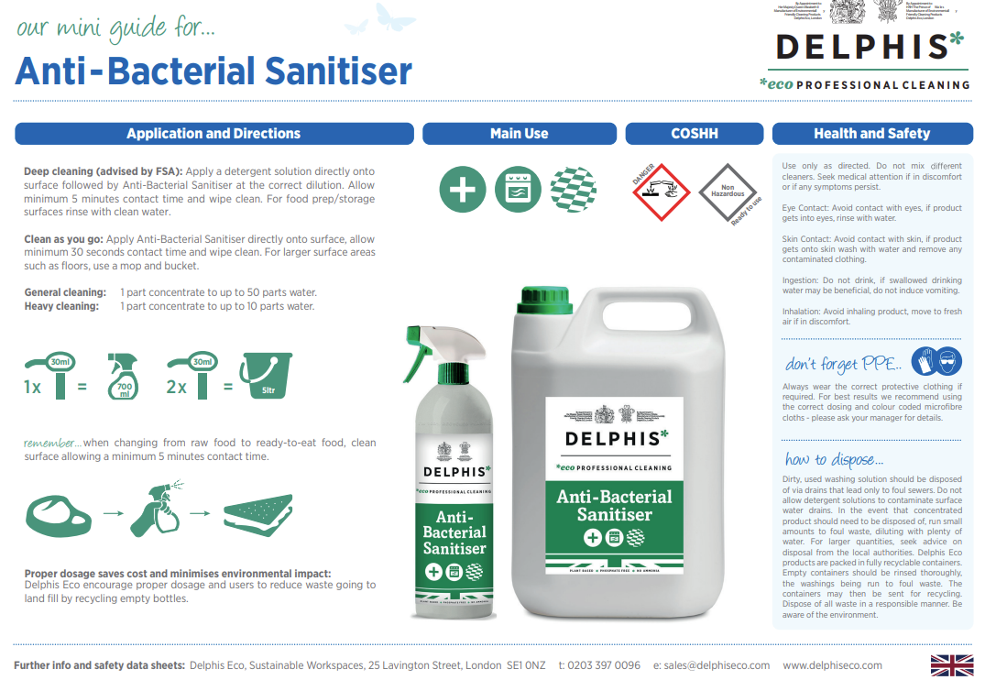
Biovate chemical documents
Due to go live this week
Delphis documents also available: https://www.mycompasshse.co.uk/sector-hse/chco/chemical-safety/

Slide 9
Contacts
hseteam@chandcogroup.com
hse@compass-group.co.uk
Out of hours emergencies - https://www.mycompasshse.co.uk/news/out-of-hours-hse-contact-wc-06012025/

