Slide 1

Vacherin Monthly H&S Meeting
March 2025

Slide 2





Audit trends this month
Shelf life inconsistencies of in-unit made items
Remove any CH&Co signage/ posters/ labels
Personal hygiene and uniform policies
Compass cleaning schedules
Notes:
Infrared thermometer calibrations - Thermometer Comparator must be used

Slide 3
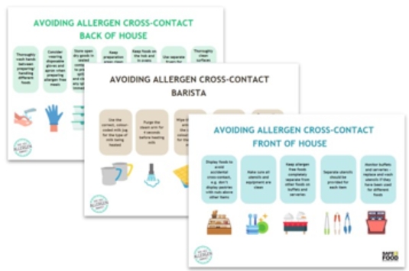
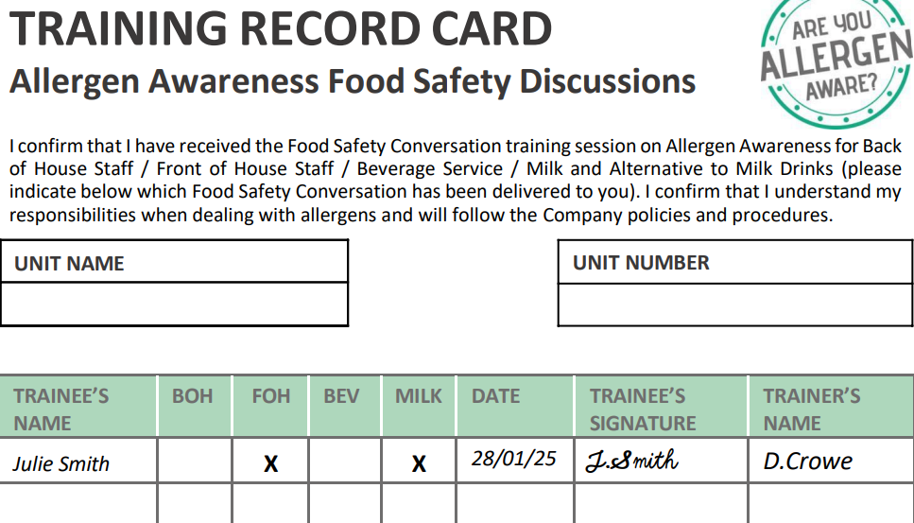
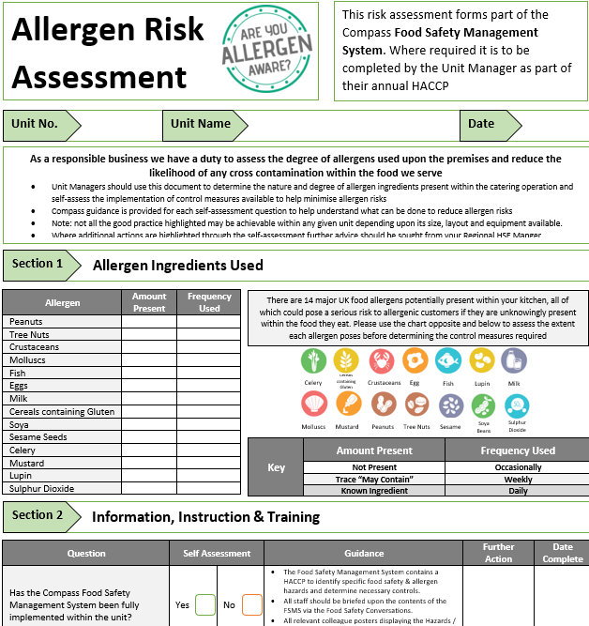
Allergens
Food safety conversations for different work requirements
Allergen risk assessment and compliance checks
Customer facing signage
https://www.mycompasshse.co.uk/food-safety/allergens-awareness/
Notes:
Infrared thermometer calibrations - Thermometer Comparator must be used

Slide 4

Net Zero Hub
Environmental questions will be asked on the food service audit from June
https://www.mycompasshse.co.uk/environment/

Slide 5
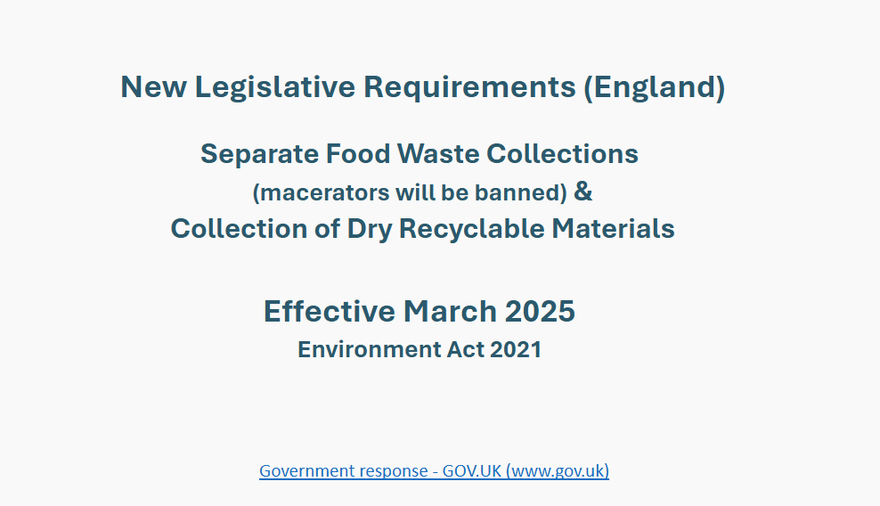
Food waste
31st March 2025 food waste must be separated by law
https://www.mycompasshse.co.uk/sector-hse/chco/simpler-recycling/

Slide 6
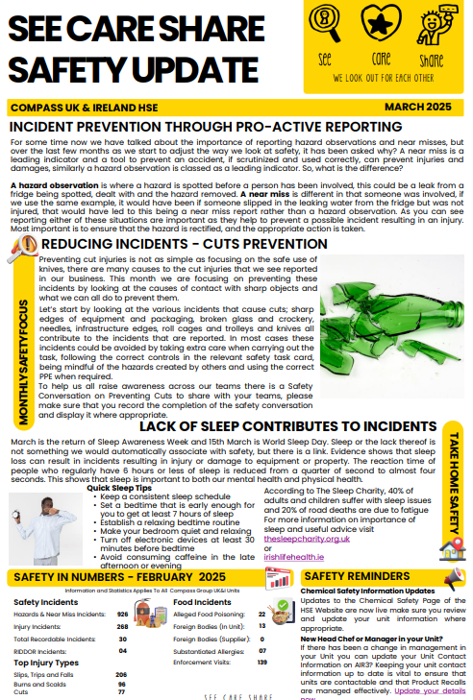
H&S meeting packs
To be used as part of monthly meeting agenda
March safety updates: Incident prevention
https://www.mycompasshse.co.uk/media/itfaru0x/see-care-share-safety-update-march-2025.pdf

Slide 7

Compass policy updates 2025
Units are no longer required to display the Policy Statements on unit notice boards (sites can display if they wish or contracts require to do so).
All employees must be made aware of the Policy Statements during their induction training.
https://www.mycompasshse.co.uk/compliance/compass-policy-statements/

Slide 8
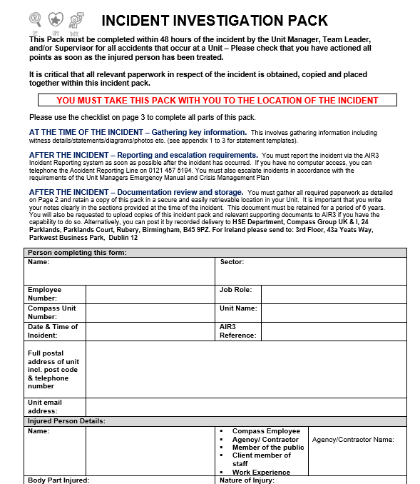
Completing Incident Investigation Packs (IIPs)
Must be completed for all injury incidents reported on Air3
You will be chased if not completed and uploaded under ‘unit review’
Signatures must be handwritten

Slide 9
Contacts
hseteam@chandcogroup.com
hse@compass-group.co.uk
Out of hours emergencies - https://www.mycompasshse.co.uk/news/out-of-hours-hse-contact-wc-06012025/

