Slide 1
Workplace Safety Management System
Compass WSMS Briefing Webinar
CATERING SERVICES
Information and Guidance for Managers

Slide 2
Agenda
Overview of the system
Key information
1
3
Completion process
Any questions?
2
4

Slide 3
Overview of the System
We want everyone, our clients, customers and colleagues, to be safe and secure, when working or dining in the areas where Compass UK and Ireland operate a service. So as part of the integration, your site will align with the Compass workplace safety system.
Health and safety processes, supporting guidance and documentation is contained within a single folder, easy for you to follow, update and work from.
What the teams say about the WSMS:
of managers found the supporting guidance extremely or quite useful
of team members found the Site Safety Information training extremely or quite informative/engaging
95%
95%


of team members found the Catering Safety Task Cards extremely or quite informative/engaging
of managers and team members agreed the new system was very good and also an improvement
98%
98%



Slide 4
Overview of the system
Completion Guide
Essential Risk Assessments
Provided in polybag – need to be placed in main folder under relevant tab
Site Safety Information Pack
Service Specific Risk Assessment(s)
Safety Task Card(s)
Training Records
Spare Material
Additional Health & Safety Documentation

Slide 5
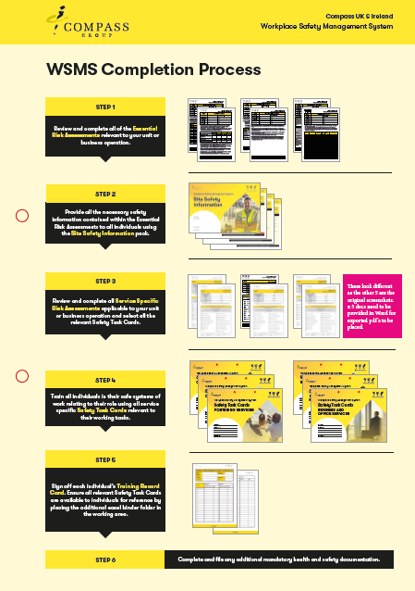
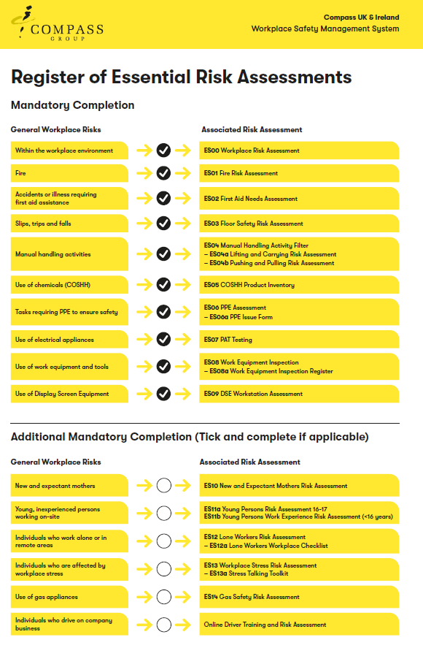
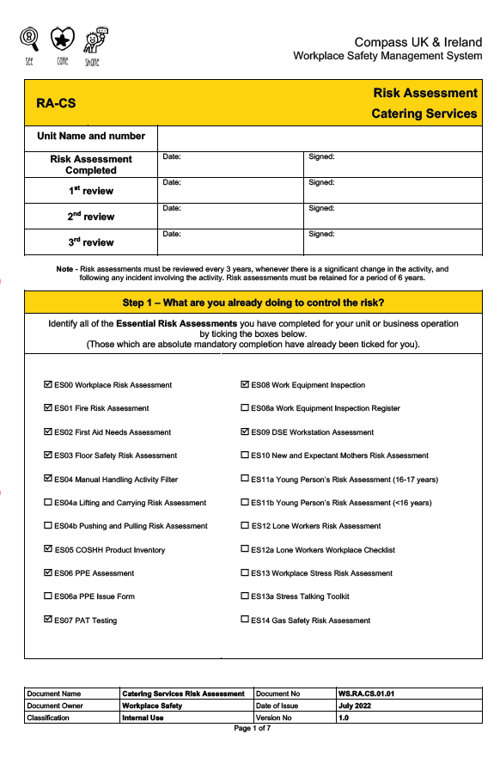
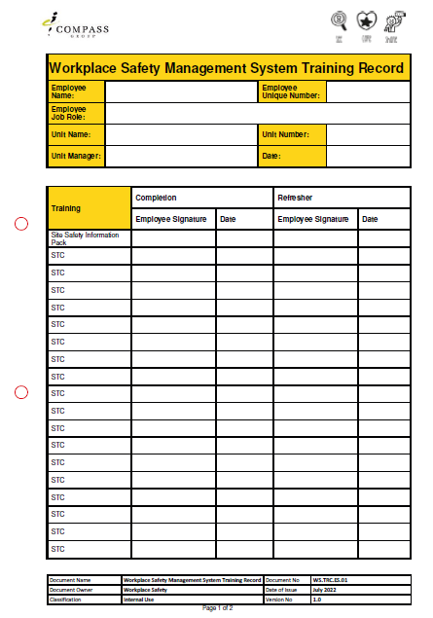
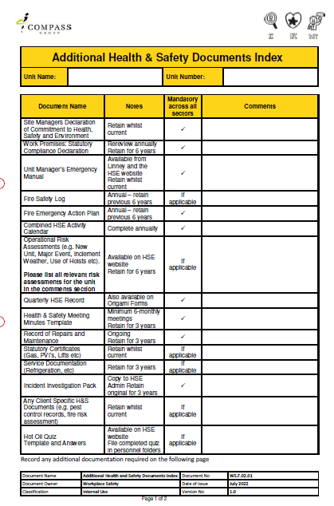
Overview of the system
Essential Risk Assessments
Site Safety Information Pack
Completion Guide
Safety Task Cards
(Catering Pack)
Service Specific Risk Assessment (Catering)
Individual Training Records
Additional H&S
Operational Forms

Slide 6
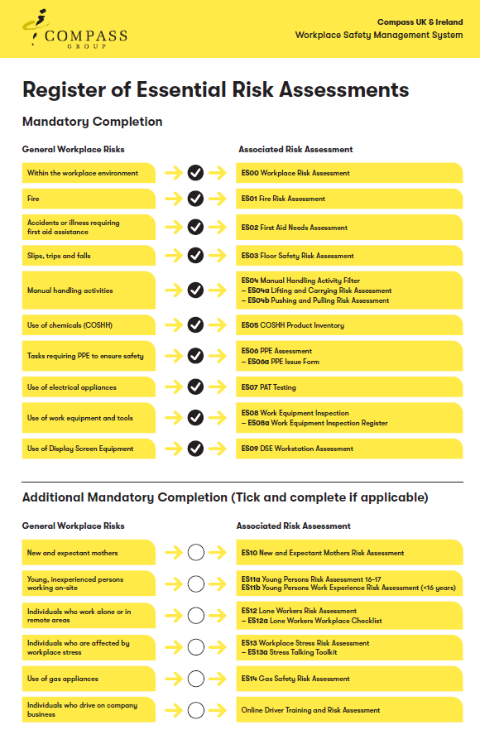
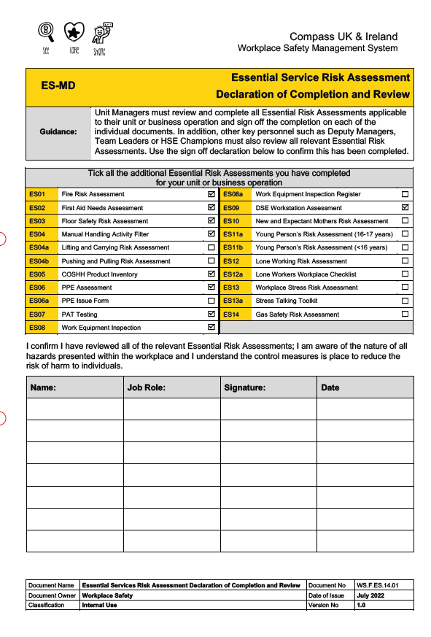
Completion Process
STEP 1
Review and complete all of the Essential Risk Assessments relevant to your unit or
business operation.
These are mandatory risk assessment that apply to all sites. These documents are now known as ‘Essential Risk Assessments’.
Select, review and complete all relevant risk assessments
Sign off the Declaration of Completion and Review
10 Essential Risk Assessments which are absolute mandatory completion (some of these have additional sub sections to complete).
These have already been selected for you.
Select all of the risk assessments applicable to your unit by ticking the relevant boxes.
Declaration of Completion and Review must be signed by all managers, deputy managers, team leaders and
HSE champions.
6 additional which must also be reviewed and completed if applicable
to your unit.

Slide 7
Completion Process
STEP 2
Provide all the necessary safety information contained within the Essential Risk Assessments to all individuals using the Site Safety Information Pack.
Key information detailed in the Essential Risk Assessments must be communicated to all individuals. To assist you with the delivery of this information, the Site Safety Information Pack has been created.
Pack consists of 23 pages, bound together as a booklet, covering the following topics:
Workplace environment hazards
Electrical safety
Fire safety
Use of gas appliances
First aid arrangements
Use of work equipment
Reporting accidents, incidents, near misses
Use of display screen equipment
Slips, trips and falls
New and expectant mothers
Safety signage
Young persons in the workplace
Manual handling
Lone working
Working with chemicals (COSHH)
Workplace stress
Use the booklet to train all individuals, or download the PowerPoint presentation from the HSE website if you prefer to present electronically to a group
Use of personal protective equipment
Driving on company business

Slide 8
Completion Process
STEP 2
Continued:
3 simple steps for unit managers to follow:
Work through the pack yourself, some pages require completion to tailor the information pack to your unit, making it site specific.
1
2
Use the pack to deliver all the necessary information to your team(s). Deliver the entire pack in one session.
2
2
Once communicated, sign off the training for each individual using the blank training records provided
in the pack.
3

Slide 9
Completion Process
STEP 3
Complete your Service Specific Risk Assessment (RA-CS Catering Services)
In addition to the Essential Risk Assessments, a Service Specific Risk Assessment has been created. This is a focus on your operating unit and covers all the hazards and risks associated with a catering environment. It also details the control measures you should ensure are in place to ensure everyone’s safety.
Step 1
Step 2
Step 3
Step 4
7 pages broken down into
4 steps:
Complete details and select all the Essential Risk Assessments you have completed
Review catering hazards and control measures, add any additional hazards which are not already documented
Select/add any additional Safety Task Cards which may be required for less common unit operations
Complete details and select all the Essential Risk Assessments you have completed
Select all core Safety Task Cards relevant to your unit operations

Slide 10
Completion Process
STEP 4
Review all Safety Task Cards relevant to your unit operations and train all individuals in their working tasks using the appropriate Safety Task Cards.
You will find a full set of ‘core’ catering Safety Task Cards in your catering services pack. Remove any Safety Task Cards which are not relevant to your unit operations and place in the ‘Spare Material’ section in your WSMS folder.
Use the list in step 3 of the Catering Risk Assessment where you selected all relevant Safety Task Cards by ticking the boxes to ensure you have all the Safety Task Cards you need.
Review all the remaining Safety Task Cards ensuring the hazards, control measures, any PPE and additional safety considerations required fully align to your team member’s working tasks.
If you identify additional hazards or the need for additional safety control measures, document these on the back of the Safety Task Card.
Use these Safety Task Cards to train individuals according to their job role and the tasks they are required to perform.
Ensure relevant Safety Task Cards are available to all individuals for reference.

If you have selected/added any ‘Additional Safety Task Cards in step 4 of your risk assessment then you will need to download and print these from the HSE website and include them in your folder.


Slide 11
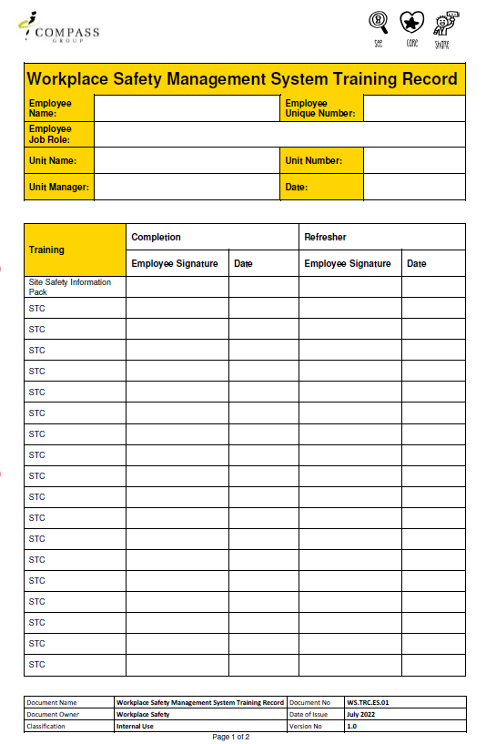
Completion Process
STEP 5
Complete the Training Record for each member of your team
Blank training records can be found in the relevant section of the WSMS folder. Use one for each member of your team. If you need additional copies, either print from the blank template, or download from the HSE website.
Complete all the details.
Train individuals using the Safety Task Cards relevant to their role. Once training is completed, ask the individual to sign and date to record their training.
Sign off training already completed for the Site
Safety Induction.
List all of the Safety Task Cards relevant to the individual's role.
Pre-poluated version is available on the website
Use this section to record additional refresher training.
File completed training records in your WSMS folder. These records can also be used when completing refresher training.

Slide 12
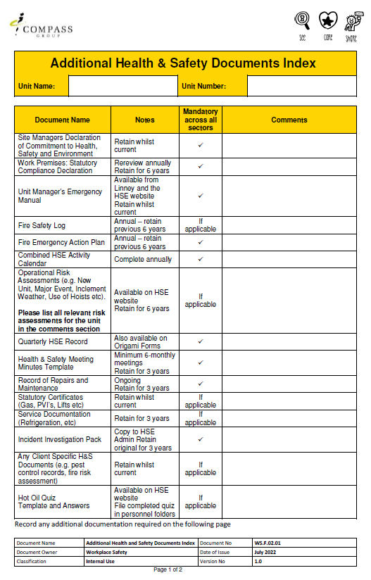
Completion Process
STEP 6
Complete and file all relevant Additional Operational Health and Safety Documentation
This section of the folder contains useful core additional health and safety operational documents.
Unit Manager’s Emergency Manual
This is included in your mobilisation box
Where documents are to be displayed these can be copied from here or downloaded and printed from the HSE website.

Slide 13
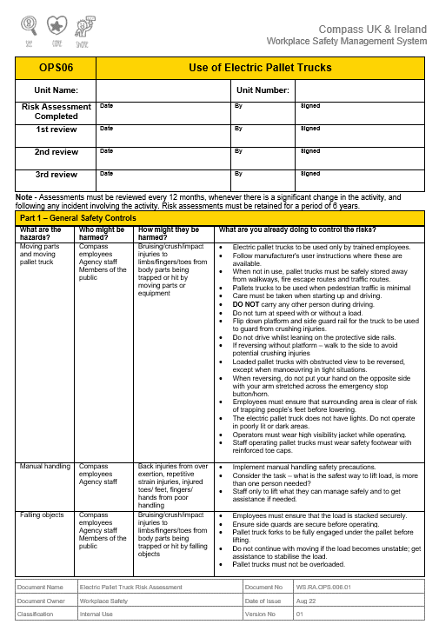
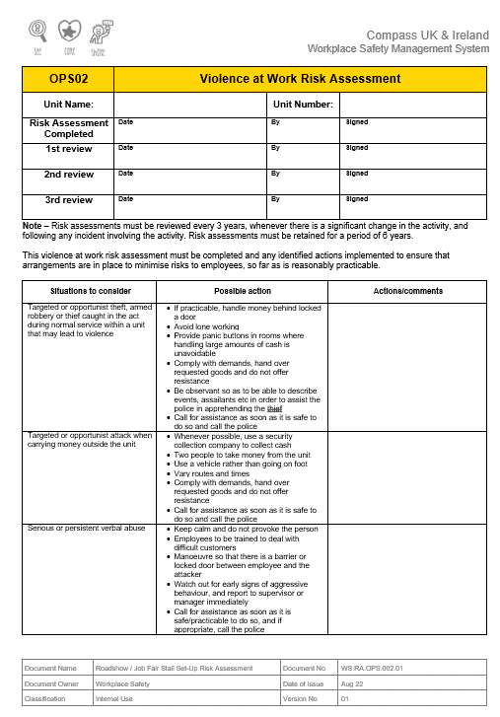
Completion Process
STEP 6
Complete and file all relevant Additional Operational Health and Safety Documentation
Operational Risk Assessment for certain activities that are not covered by the Essential Risk Assessments, Catering Services Risk Assessment or Task Cards must be downloaded from the website and added to this section.
Download and complete additional
OPS RAs as required:
Rider Operated Lift Trucks
Electric Pallet Trucks
Work Adjustment
All units should download and complete OPS02 Violence at Work Risk Assessment

Slide 14
Key Information
DON’T OVER COMPLICATE IT
ALLOW TIME
RETENTION PERIODS
Keep any current risk assessments and also all documentation which has been replaced as part of the new system.
Make sure your WSMS folder is filed in a safe place and available to auditors.
Review risk assessments as required and deliver refresher training periodically.
Complete all relevant Essential Risk Assessments.
Deliver the Site Safety Information pack to all individuals.
Review and complete the Catering Services Risk Assessment.
Train individuals in their working tasks using the relevant Safety Task Cards and complete their Training Record
Allocate sufficient
time to work through the new folder.
Work through in stages if this helps.
The entire folder must be fully implemented within 4 weeks of integration.
Speak with your HSE Manager or Sector Lead if you have any questions or concerns.

Slide 15
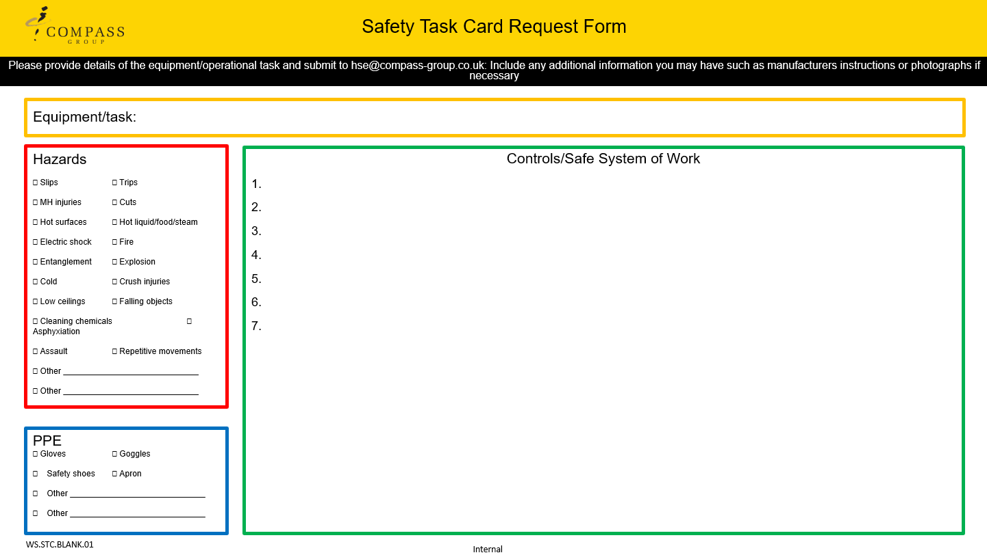
Key Information
Process for Requesting Documents for any additional Tasks or Equipment to be included
If you identify that any tasks carried out or equipment used in your unit is not covered by the core Safety Task Cards or the Additional Safety Task Cards on the Compass website:
Download the Additional STC Request
A draft STC will be sent to you for review and once finalised this will be added to the website
Complete the form
Collate supporting documents/photos
Send to the email provided

Slide 16
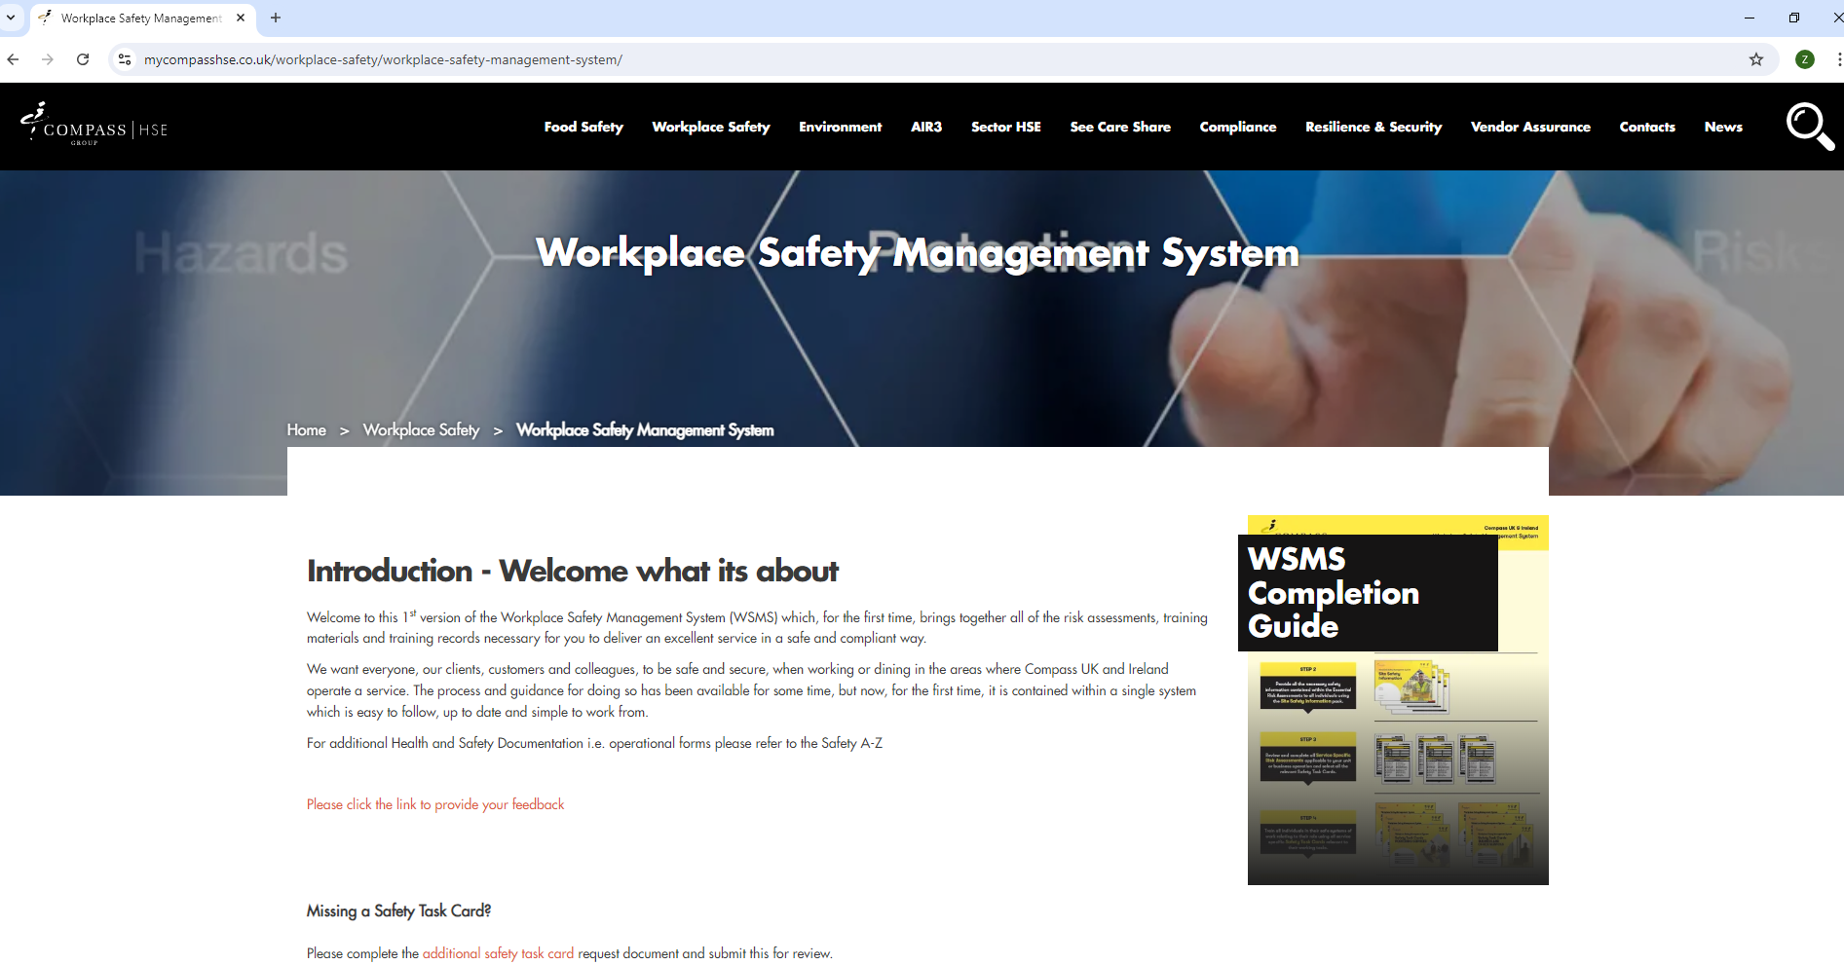
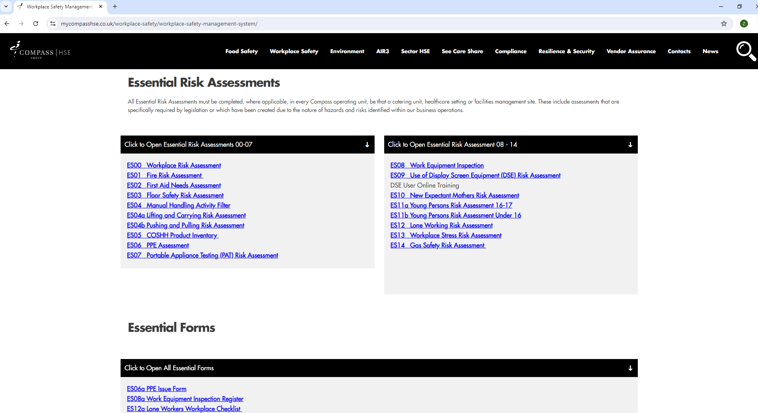
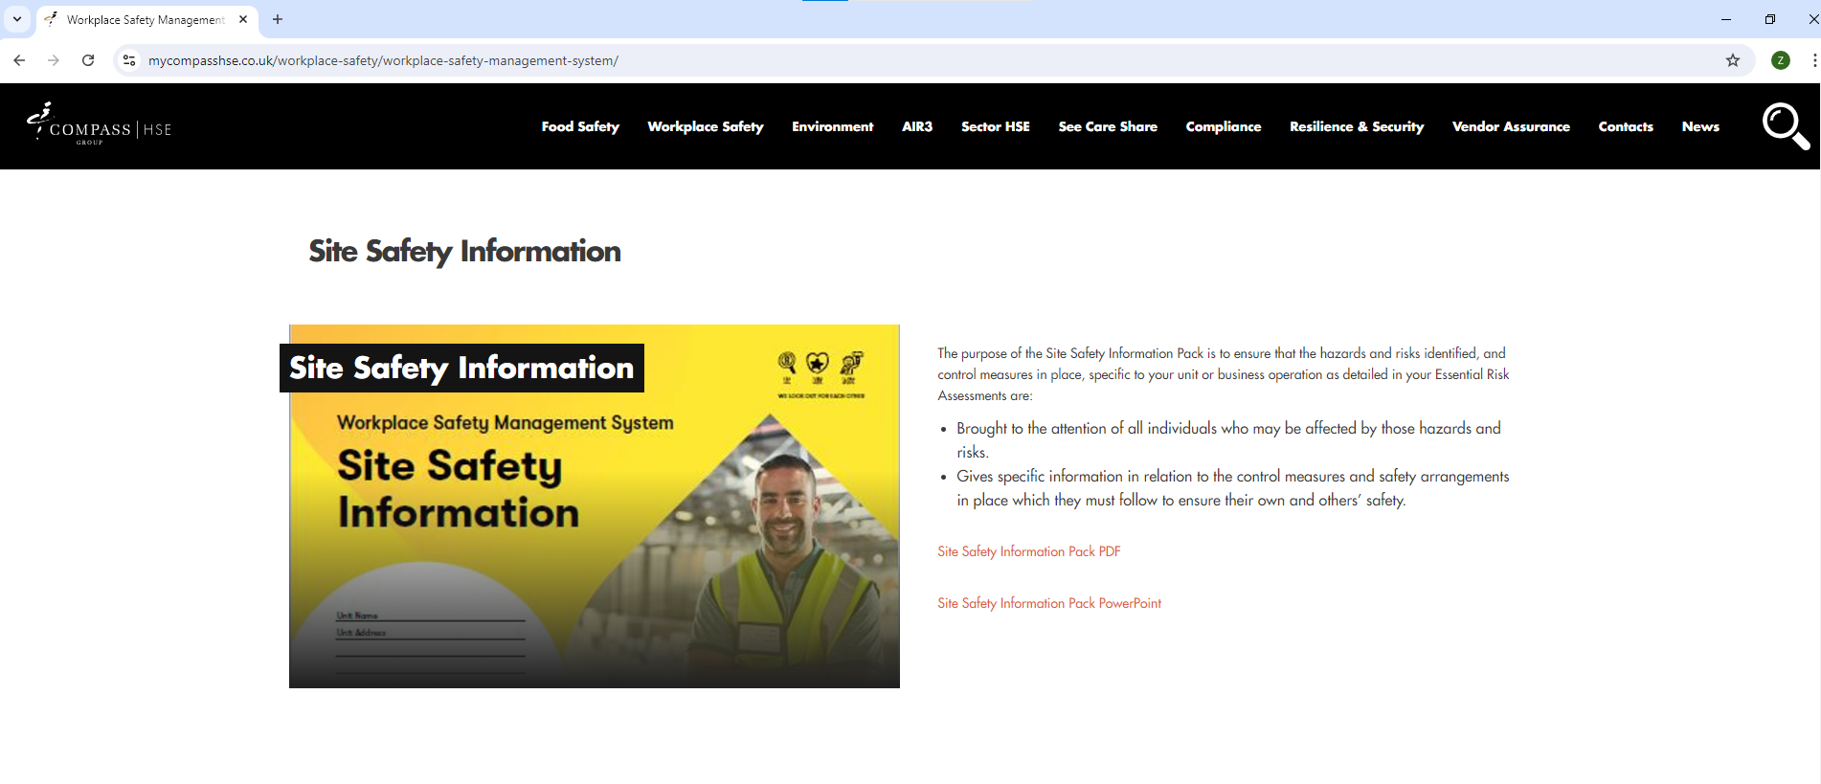
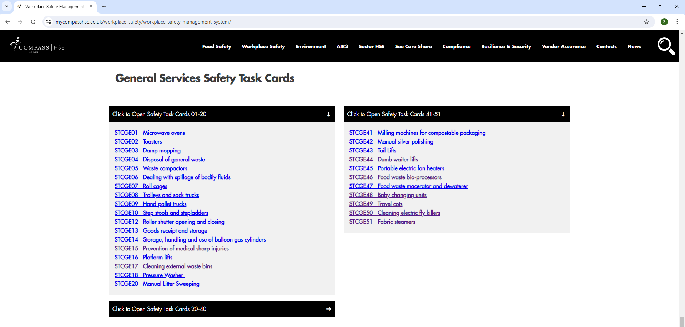
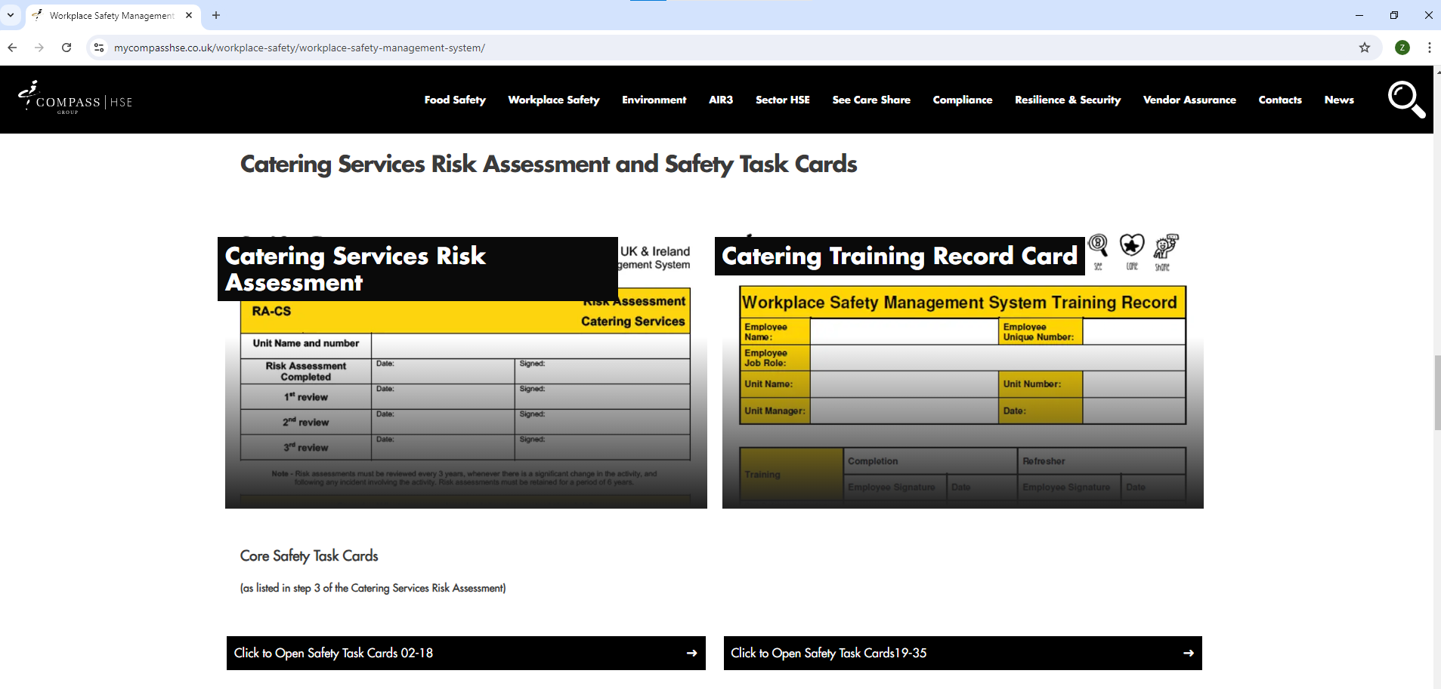
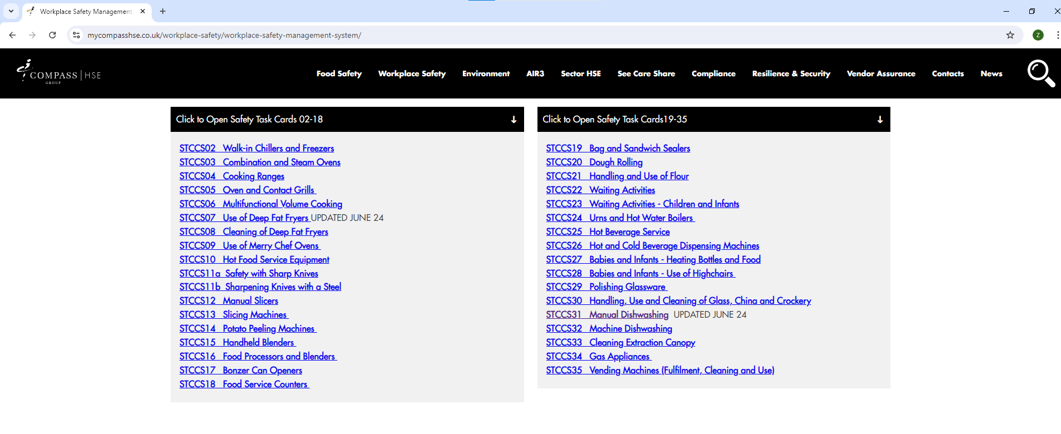
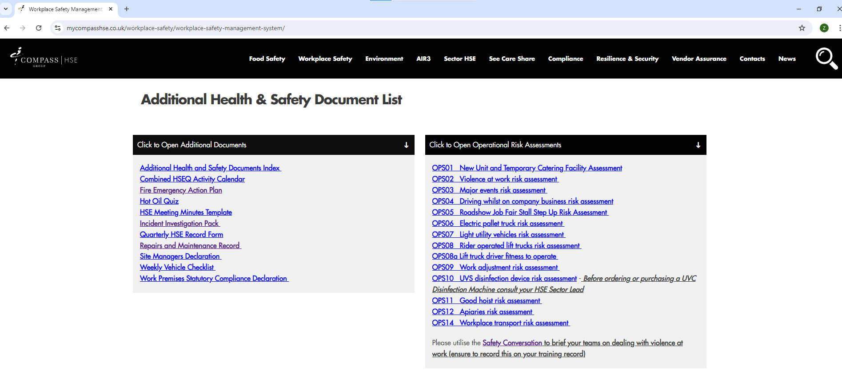
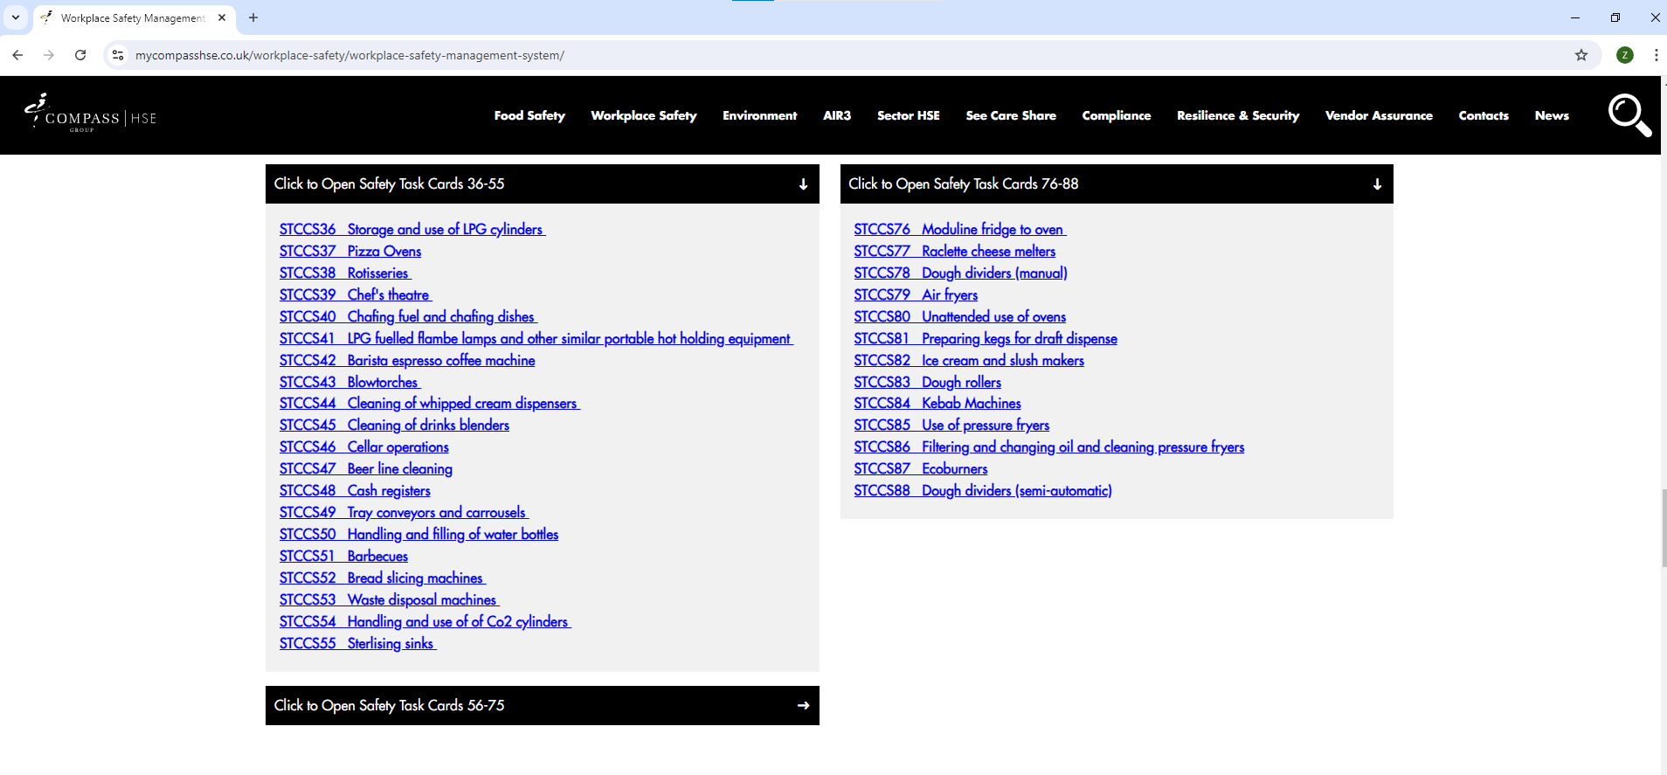
Compass HSE Website
All components and documents in the Folder and Service Specific Packs are available on the website

Slide 17
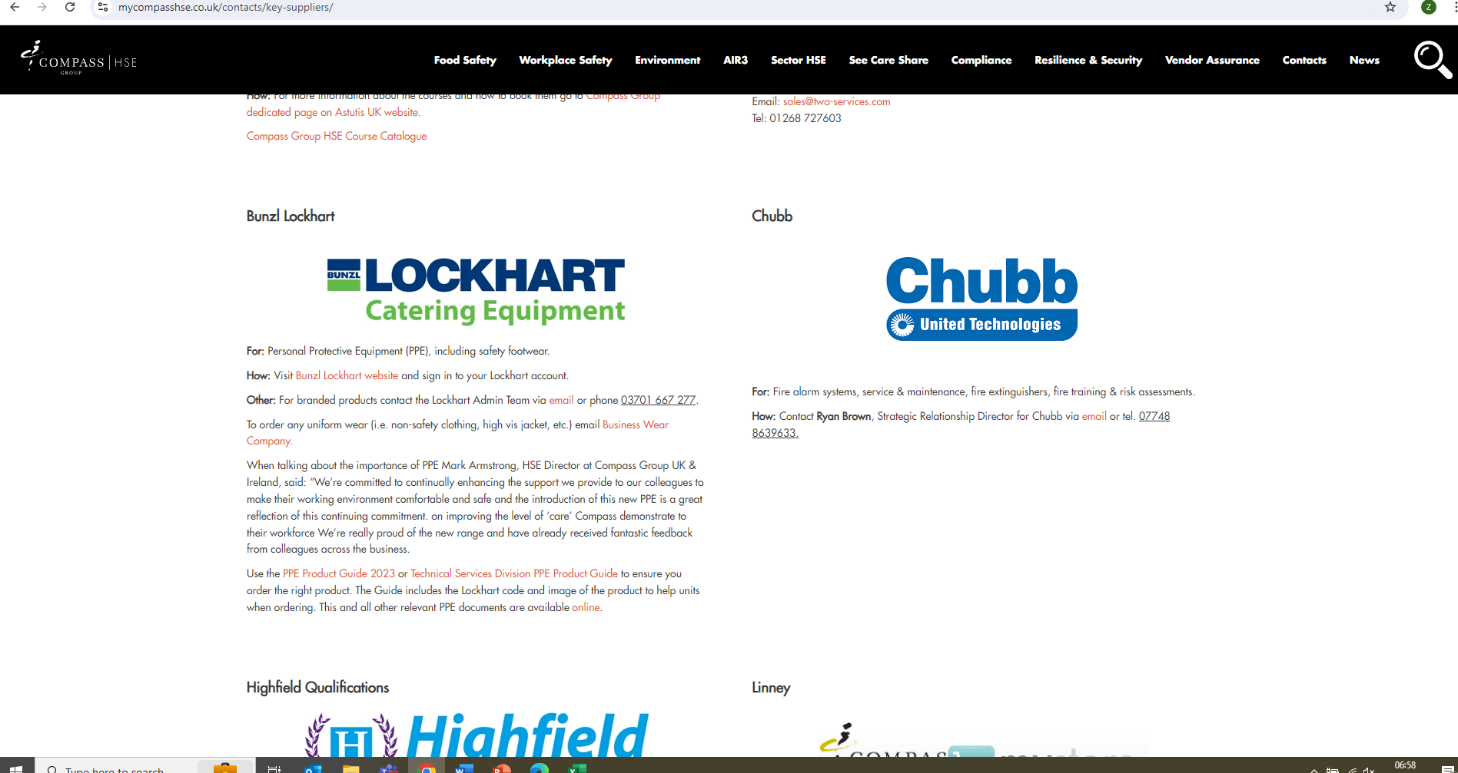
COMPASS HSE WEBSITE
Under Workplace Safety
– T: Temporary and Agency Workers Guidance and Induction documents
Contacts
Contacts – PPE catalogue
Safety A-Z

Slide 18
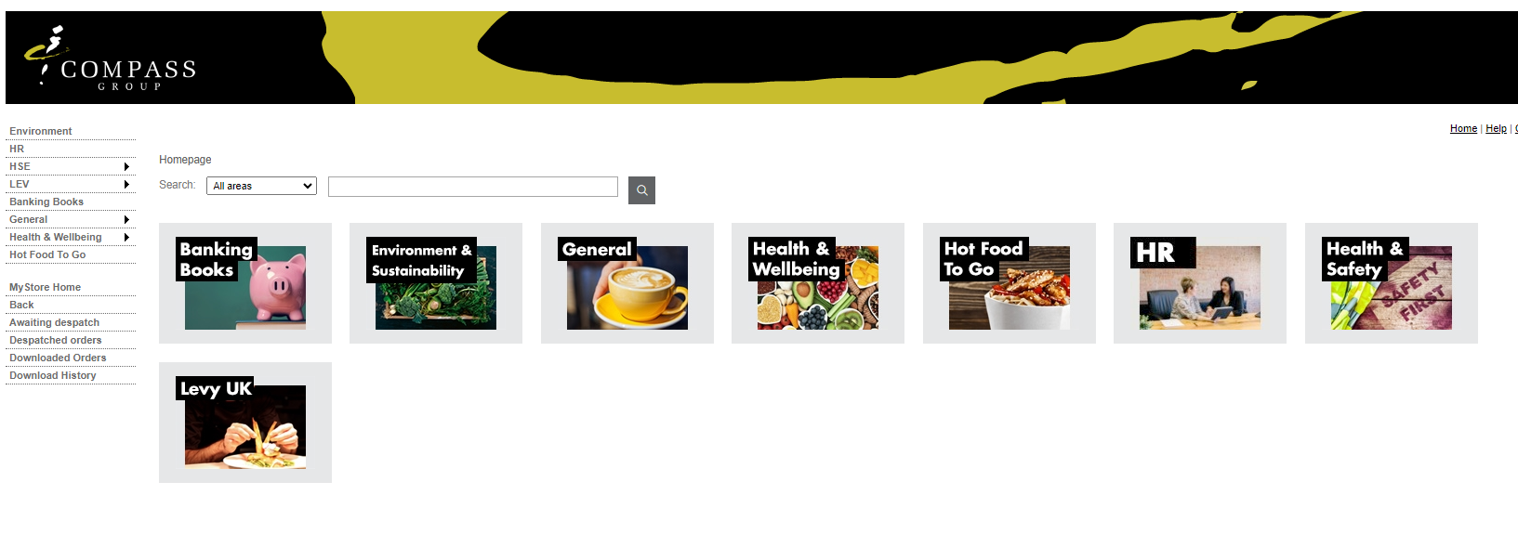
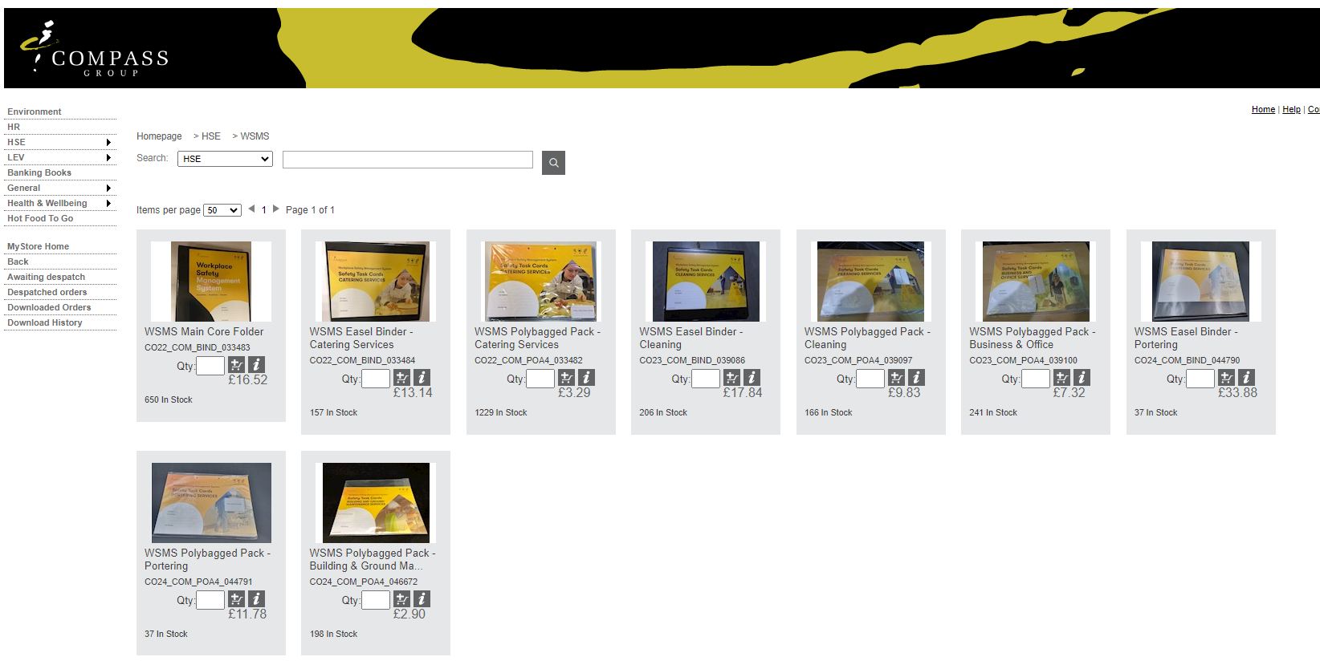
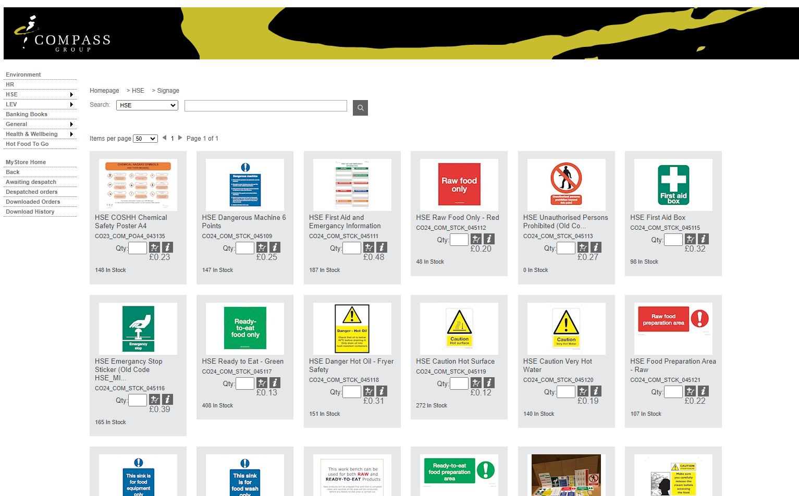
Linney MyStore
Hard copies of the folders can be purchased on Linney. Useful signage and posters are also available to be purchased.
Workplace Safety
Labels

