Slide 1
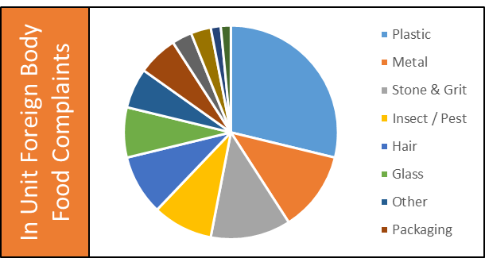
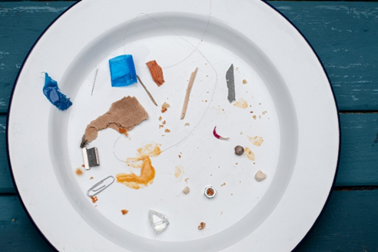
Safety Moment
Preventing In Unit Foreign Body Food Complaints
1
Open food packaging carefully ensuring that any excess packaging is disposed of in the waste bin
Foreign bodies found in food are our biggest cause of food safety complaints. Each incident contributes towards our company Food Safety Incident Rate that measures our overall performance.
A wide range of physical contaminants are involved, with plastic, metal and stone/grit top of the list of items most frequently found
2
Follow good personal hygiene rules whenever handling food ensuring clothing & uniform is in good condition and jewellery is removed
In Unit Foreign Body Food Complaints
3
Ensure glass products are removed from the kitchen where possible
The biggest cause of customer foods safety complaints
4
Check the condition of storage containers, cooking equipment and serviceware before use
5
If a food complaint is received ensure you obtain all the necessary details regarding the foreign body type and the preparation & cooking method.
6
Report all incidents via AIR2
FS/SC/017/01

Slide 2
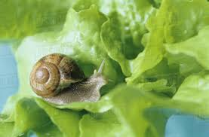
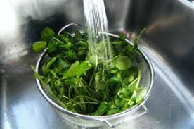
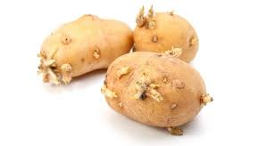
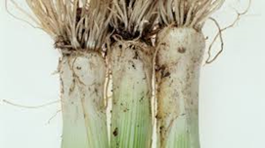
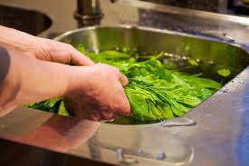
Safety Moment
Preventing In Supplier Foreign Body Food Complaints
1
Always examine food ingredients before use to identify and remove any foreign body objects
A greater percentage of foreign bodies found in food come through our supply chain, but there are measures a unit can take to minimise these ending up upon the customers plate.
2
Ideally sieve powdered or fine grain products to remove any foreign body objects before use
Supplier Foreign Body Food Complaints
3
All non pre-packed salad leaves, salad vegetables and unpeeled fruit to be sold as ready to eat must be thoroughly washed (unless stated pre-washed)
4
Use running water in a food preparation sink to remove soil and grit from vegetables and salad leaves
5
Agitate salad leaves vigorously in the water ensuring that all visible soiling is removed
6
Examine and wash baked potatoes before cooking to remove dirt, sprouting buds or stones embedded in the skin

