Slide 1
Compass Food Safety Management System
Information and Guidance for Unit Managers and Head Chefs

Slide 2
AGENDA
Compass FSMS Overview
Other Forms
The FSMS Folder
Compass HSE Website
The Training Folder
Linney
Posters, Logbook & Forms

Slide 3
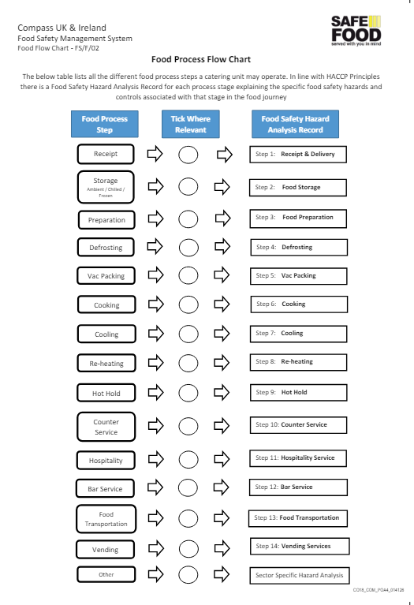
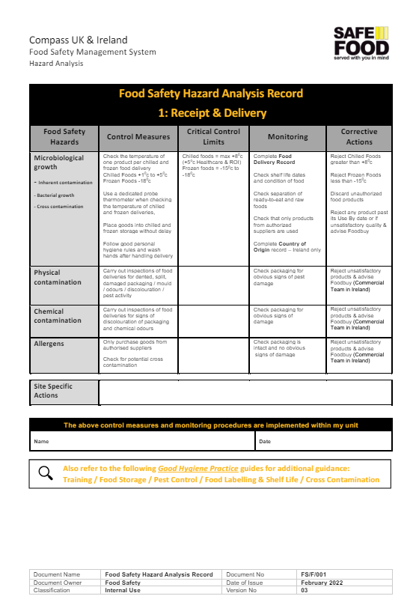
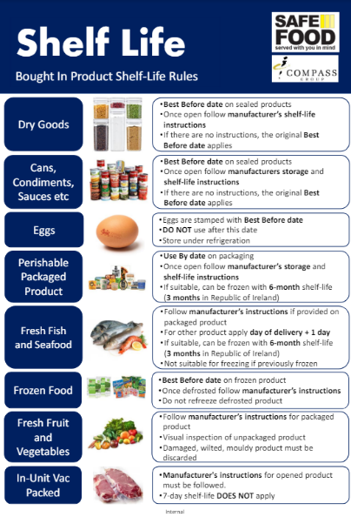
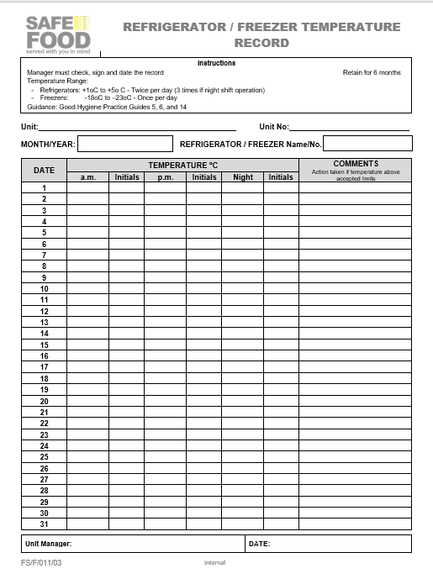
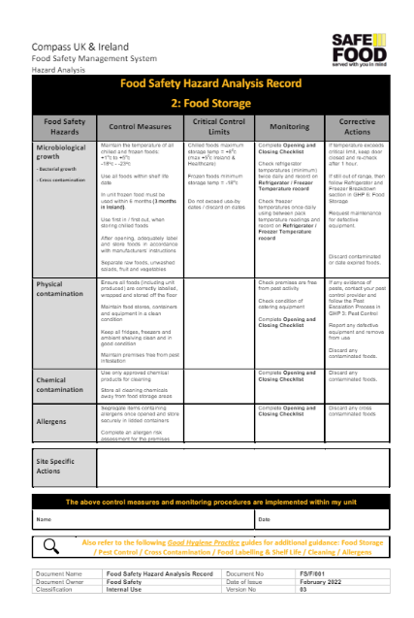
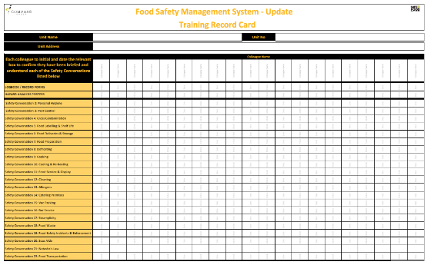
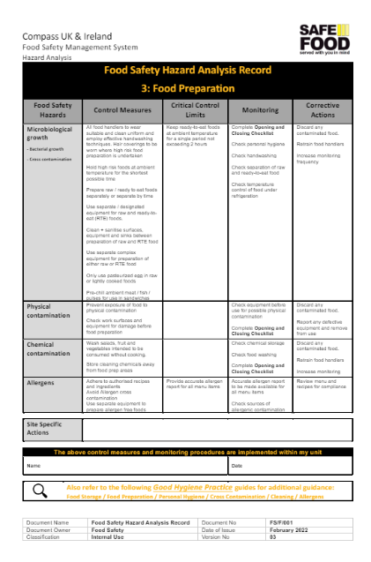
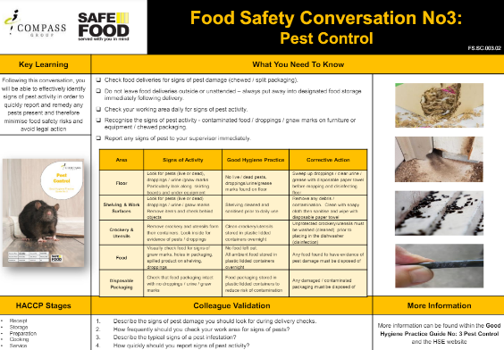
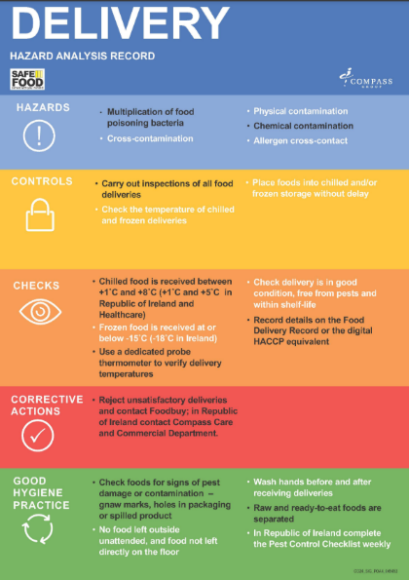
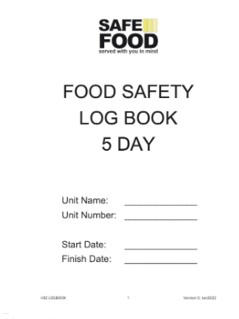
COMPASS FSMS OVERVIEW
The Compass Food Safety Management System is made up of several elements, and it is important that all elements are completed correctly and implemented throughout your unit.
FSMS Folder
Training Folder
Posters
Records
Food Process Flow Chart
Hazard Analysis Records
Good Hygiene Practices
Food Safety Conversations
Training Matrix
HACCP and Shelf-life
Logbook
or Forms

Slide 4
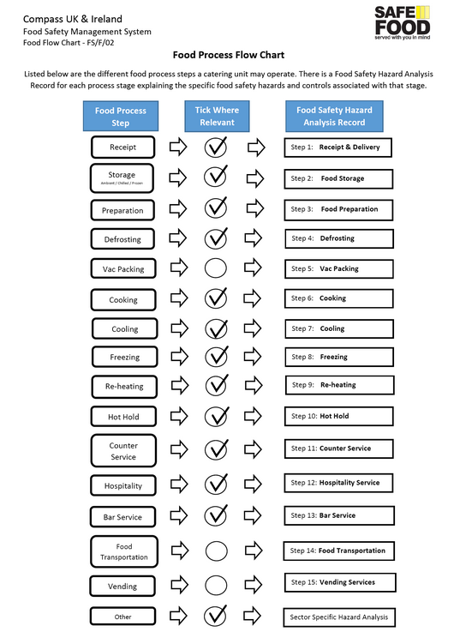
FSMS FOLDER
Food Process Flow Chart
The Flow Chart lists food processes that a catering unit is likely to operate
Review the Flow Diagram and select the relevant steps that apply to your unit, by ticking circle for that stage.
This determines which Hazard Analysis Records you need for your unit.

Slide 5
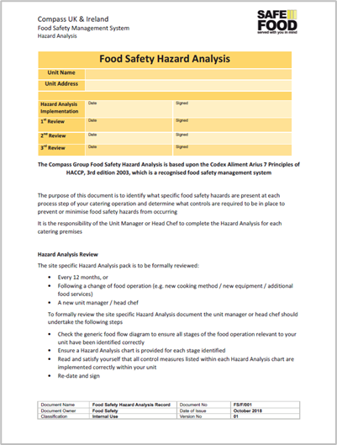
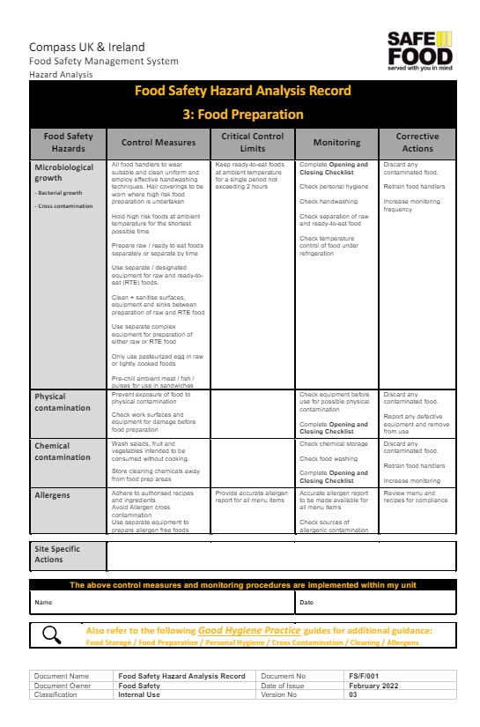
FSMS FOLDER
Food Safety Hazard Analysis
Complete the front page of the Food Safety Hazard Analysis document.
Remove any Hazard Analysis Records that do not apply to your operation from the pack.
Review each Hazard Analysis Record to:
Understand the hazards listed in each process
Understand the control measures required to prevent the hazards
Check what the monitoring procedures are and make sure they are put in place at your unit
Sign and date each process step

Slide 6
FSMS FOLDER
Good Hygiene Practice Guides GHPs
There are currently 23 GHPs which include details and guidance that underpin the Hazard Analysis Records
You should be familiar with the contents and use them for reference when required.
The core GHP’s cover the following topics:
1. Food Hygiene Training
2. Personal Hygiene
3. Pest Control
4. Cross Contamination
5. Food Labelling & Shelf Life
6. Food Receipt & Storage
7. Food Preparation
8. Defrosting
9. Cooking
10. Cooling & Re-heating
11. Food Service & Display
12. Cleaning
13. Allergens
14. Catering Premises & Equipment
15. Vac Packing
16. Bar Service
18. Food Waste
19. Food Safety Incidents & Enforcement
21. Natasha’s Law
22. Food Transportation
Additional GHP’s:
17. Steamplicity
20. Sous Vide
23. Halal & Kosher

Slide 7
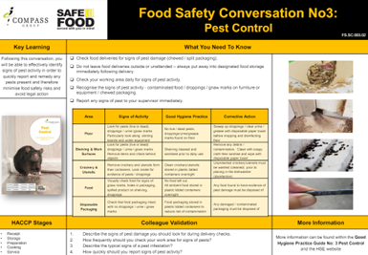
TRAINING FOLDER
Food Safety Conversations (FSCs) and Training Matrix
There is a Food Safety Conversation for each of the GHPs.
These conversations should only take 5 to 10 minutes each to complete.
Work through these with your teams until everyone is trained relevant to their job role
Use them for refresher training or briefings
Record all training in the Training Matrix

Slide 8
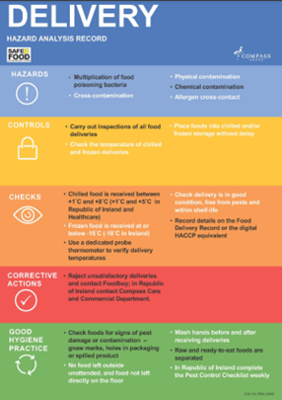
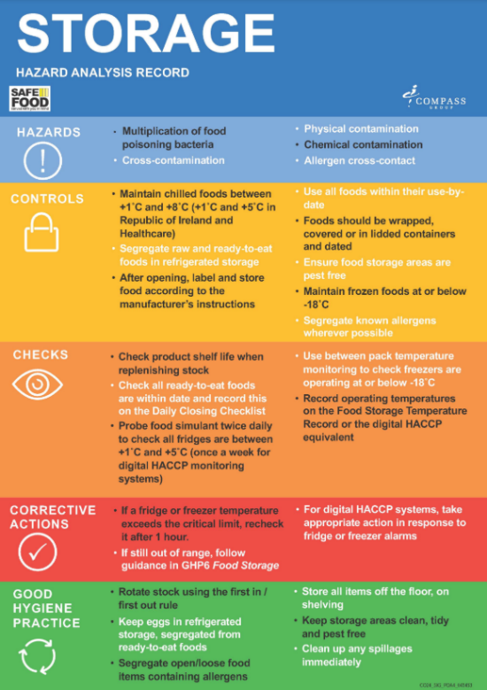
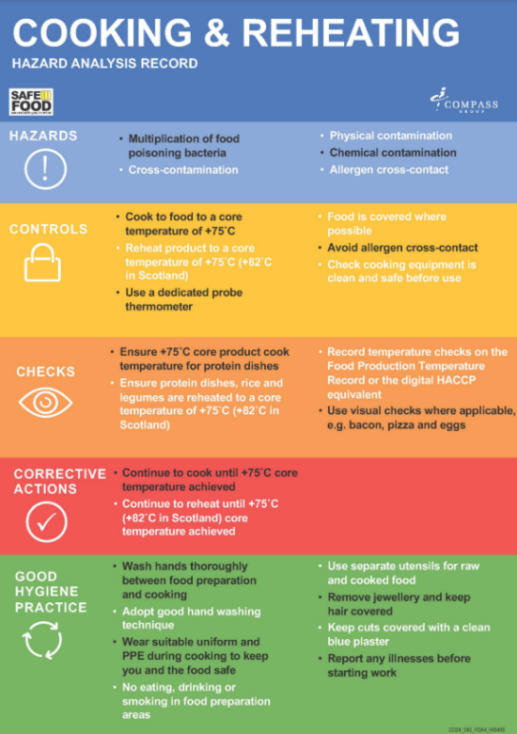
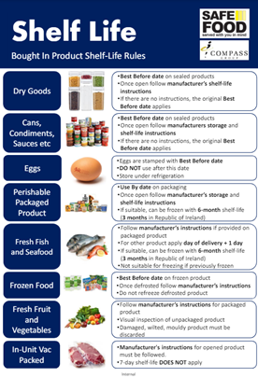
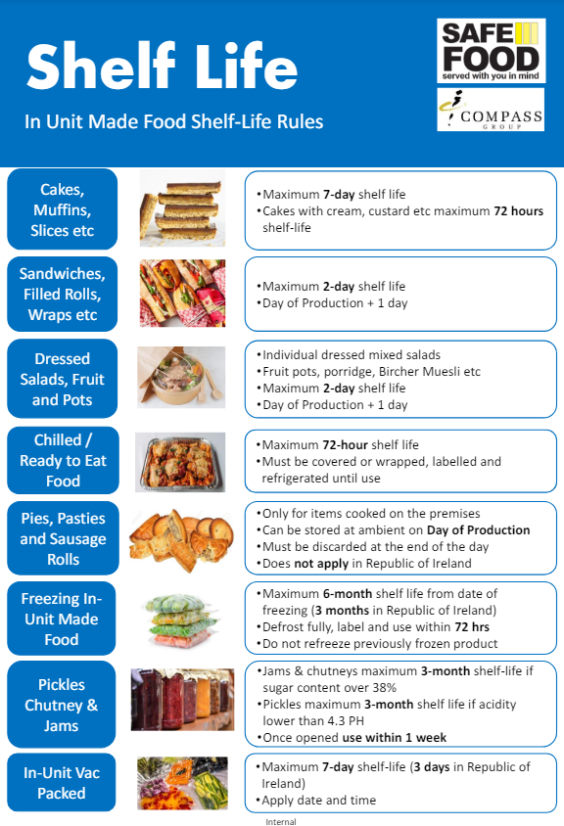
POSTERS
HACCP Posters
Shelf-Life Posters
There are 11 colleague posters which contain the most important information from the Hazard Analysis Records and the relevant Good Hygiene Practice Guides
These 2 colleague posters summarise the date labelling and storage information
Display each poster in the kitchen or unit where it is relevant
Walk through the unit with your team to brief them on the relevant posters and information

Slide 9
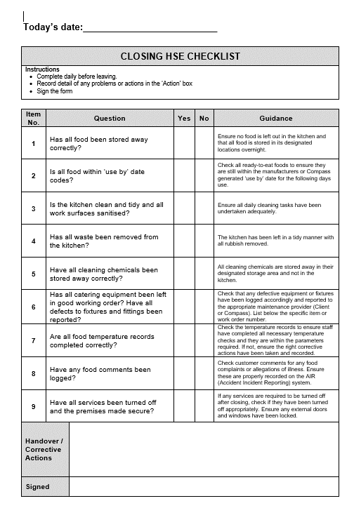
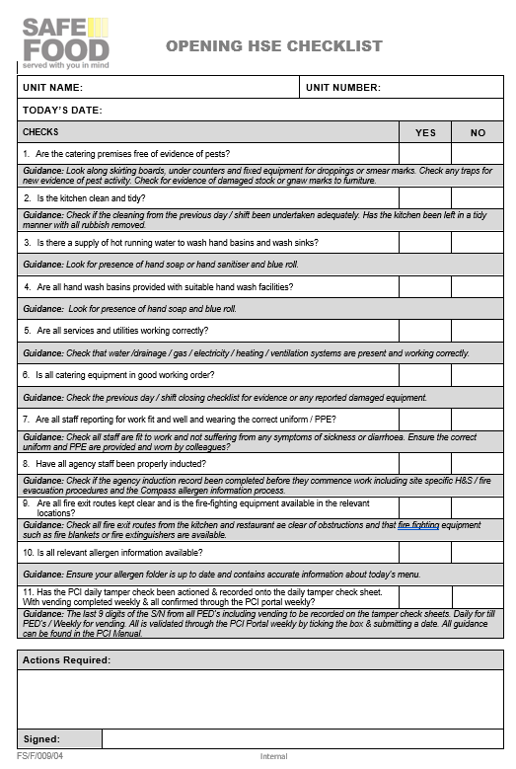
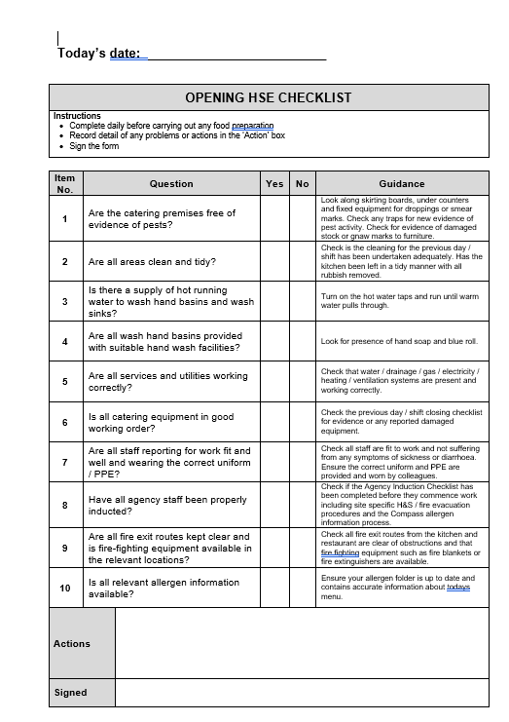
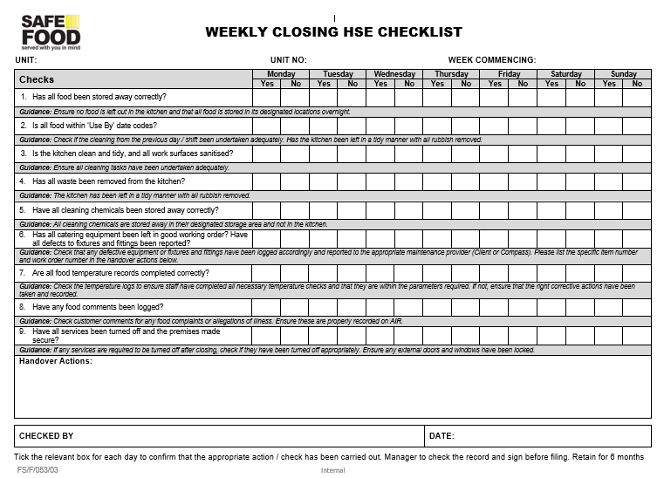
LOGBOOK or FORMS
Opening and Closing Checks
Each day of the logbook starts with an opening HSE Checklist and ends with a Closing HSE Checklist
Where logbooks are not used, weekly or daily opening checklists can be downloaded from the website
The checks should be completed by the most senior person in the area
Complete by confirming Yes / No using the guidance for each question
For any ‘No’ response, detail corrective action or relevant comments in the box at the bottom of the page

Slide 10
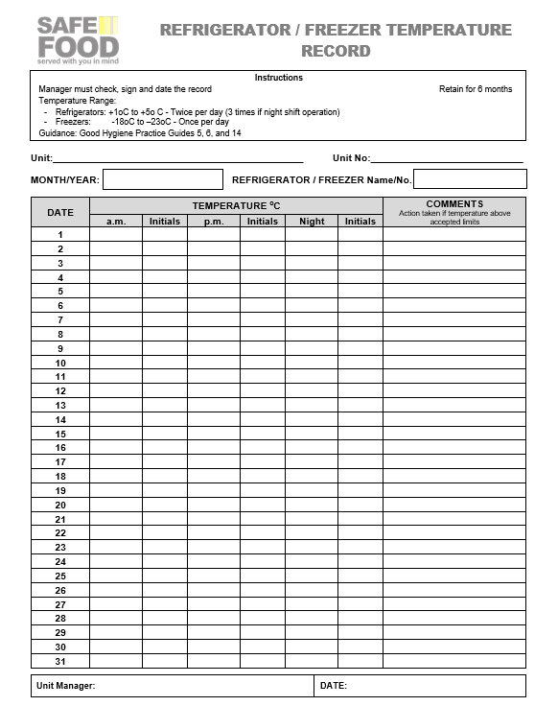
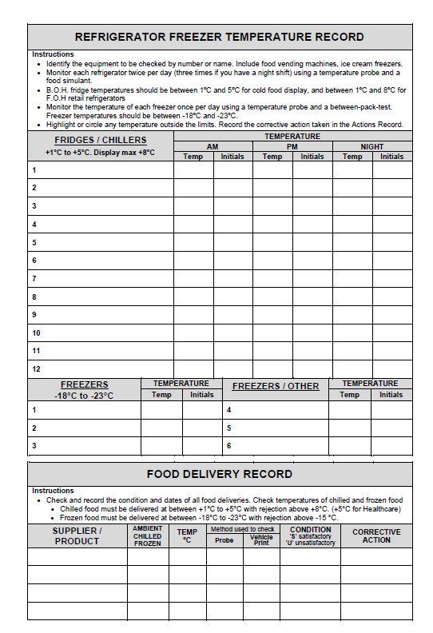
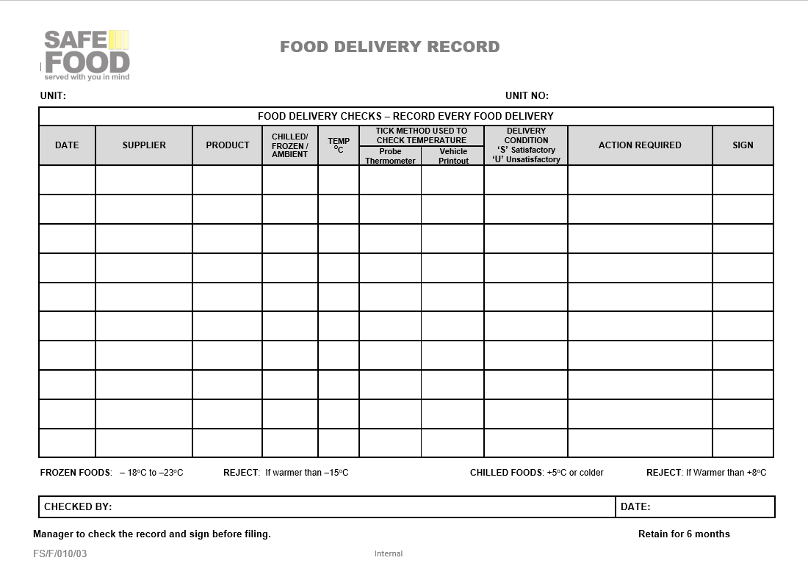
LOGBOOK or FORMS
Fridge and Freezer Checks
Delivery Record
Record fridges twice daily – probe food simulant (lard/butter or jelly)
Record freezer temperatures once daily – insert probe between two packs of food
Where a temperature is out of range this must be escalated, noted in comments and the temperatures checked again within a 60-minute period
If the temperature is still out of range take action as per the GHP 6 – Food Storage
All food deliveries are to be recorded daily at the bottom of the page (ensure high risk deliveries are prioritised) or on the Food Delivery Record.

Slide 11
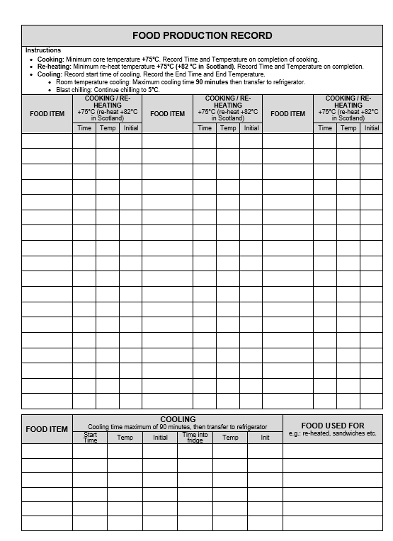
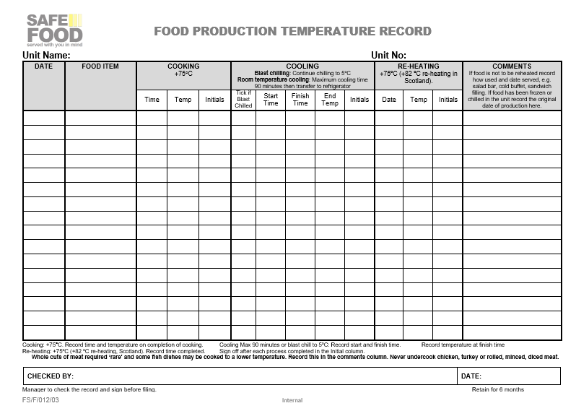
LOGBOOK or FORMS
Food Production Records
Cooking, cooling and reheating is all recorded on this page/form
Minimum cooking and re-heating core temperature is 75⁰C (exemptions in GHP9)
Use comments section to provide relevant information such as where/how food is being used
Whoever is recording the temperatures must initial the relevant box

Slide 12
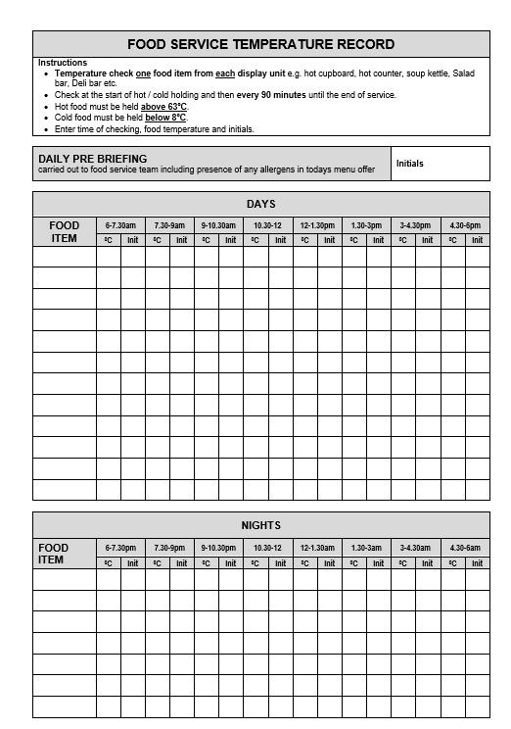
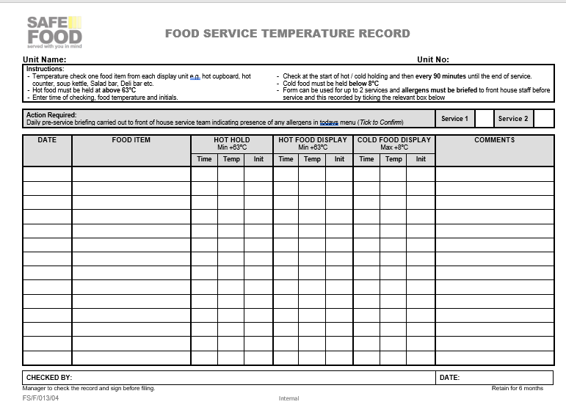
LOGBOOK or FORMS
Food Service Records
Record to be completed for any food service this includes hot cupboard, hot counter, soup kettle, Salad Bar or Deli Bar
In the logbook service time slots are provided
GHP 11 - Food Service & Display provides additional information regarding holding times and exceptions i.e. 2-hour rule and 4-hour rule

Slide 13
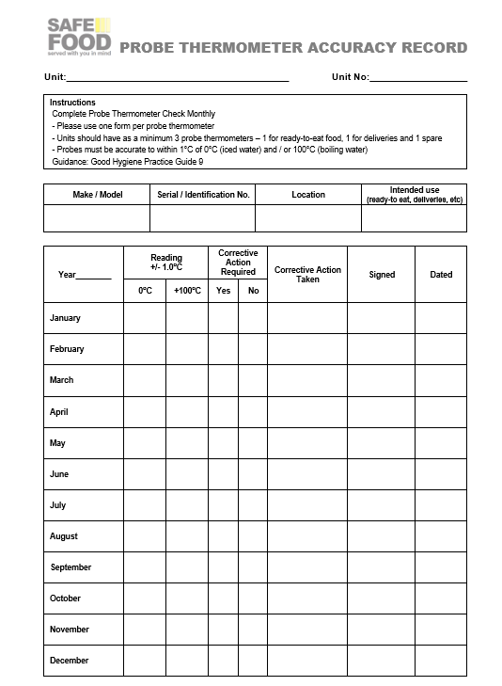
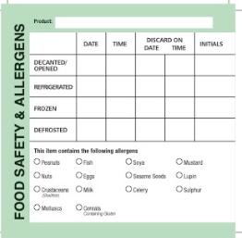
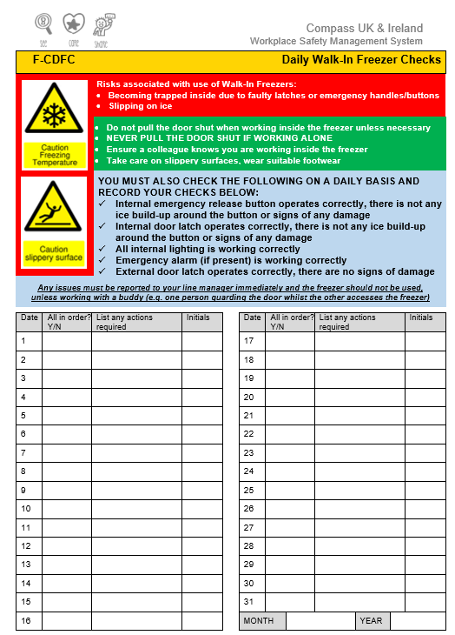
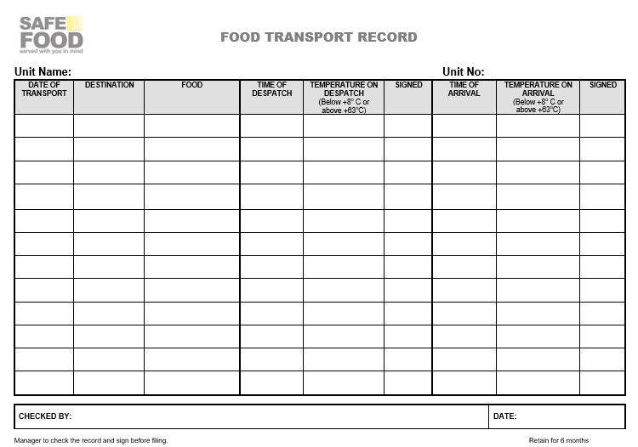
OTHER FORMS
Probe Calibration
Shelf-Life Labels
Probe thermometers must be calibrated monthly
Form is provided in the logbook every 4 weeks
Hot (boiling water) or cold (ice water)
Fresh food generally 72 hours shelf-life
Ensure time is noted
Follow guidance in GHP or on Poster for cakes, sandwiches, fresh fish and seafood etc
Frozen food 6-months shelf-life
Ensure allergens are completed consistently
Food Transportation Records
Walk-In Freezer Door Checks
Temperature checks required if transporting foods from your unit to another location
Form available on the website
Daily check of freezer door mechanism

Slide 14
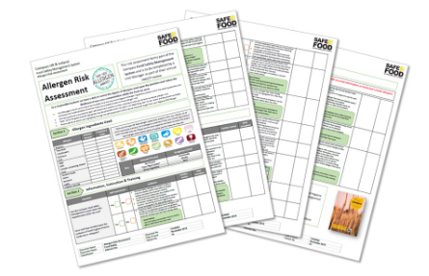
ALLERGEN MANAGEMENT
Allergen Risk Assessment
Unit Manager or Head Chef must complete
Self-assess implementation of control measures to minimise risks associated with allergens
Guidance provided for each question
It may not be possible to achieve all good practices highlighted, depending on unit layout, size, equipment, menu etc.
Seek advice from your HSE manager if additional actions are highlighted
File with your FSMS
Review annually

Slide 15
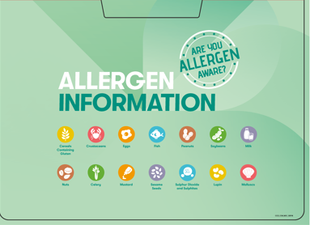
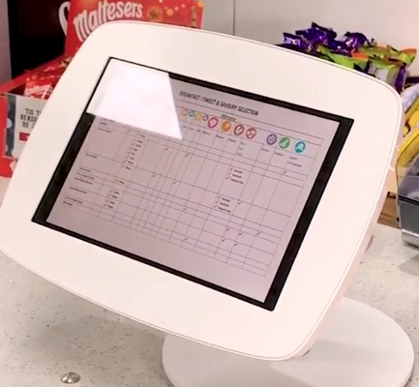
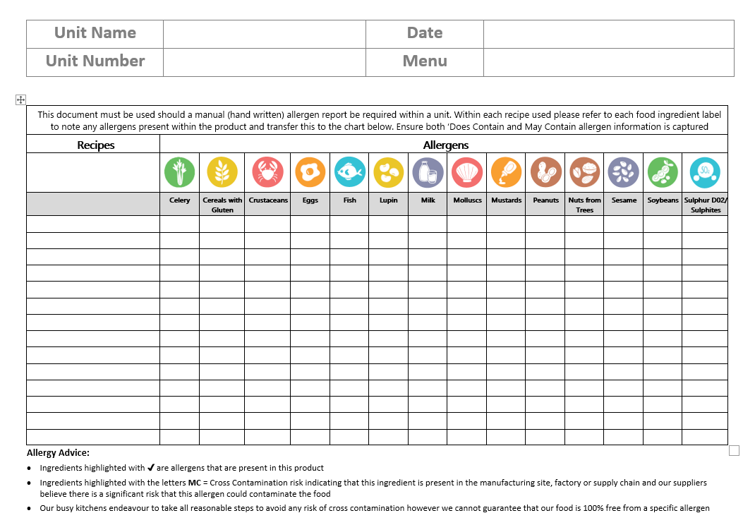
ALLERGEN MANAGEMENT
Allergen Information
Allergen information created from the Source
Paper allergen logs
Allergen tablet
QR Code
Manual Allergen Logs
Customer Facing Material

Slide 16
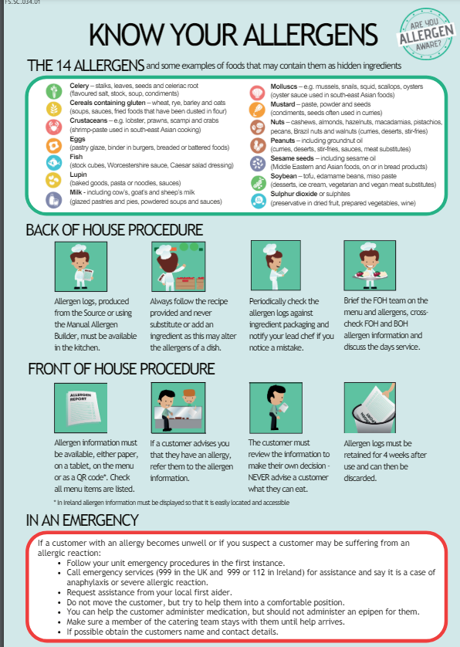
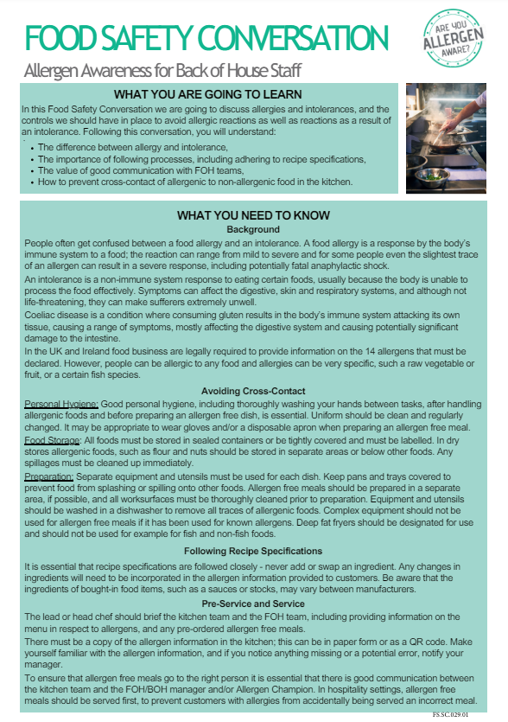
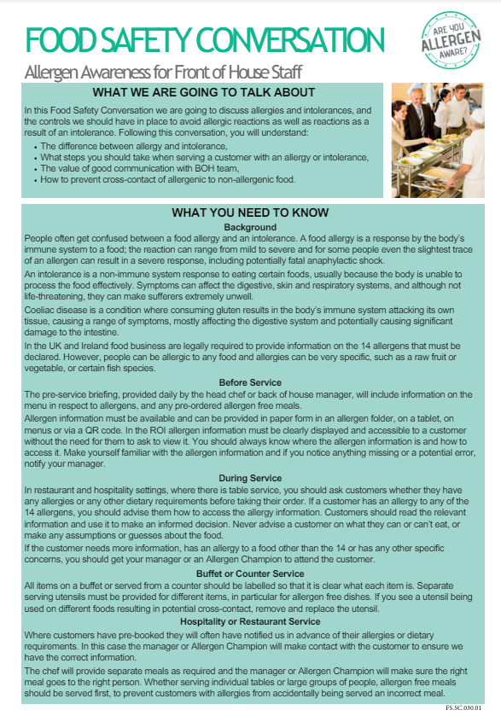
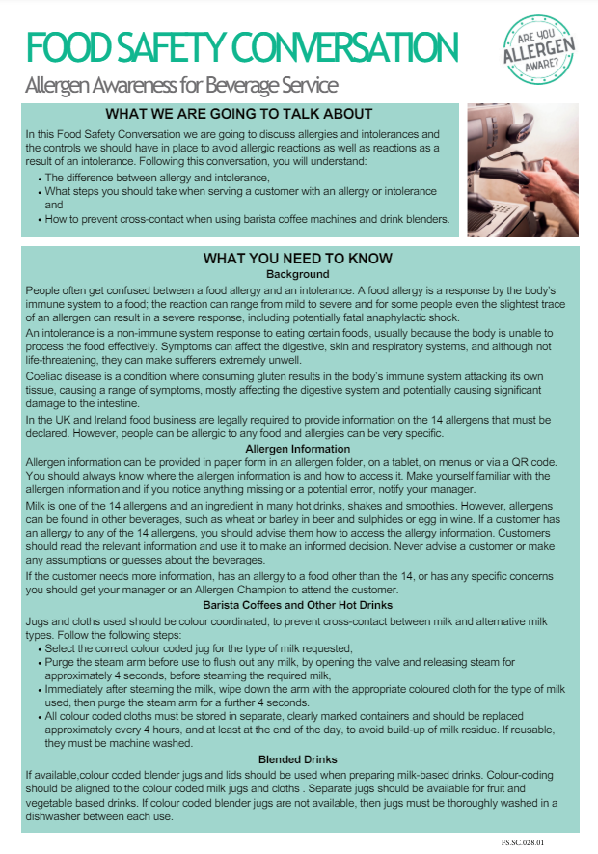
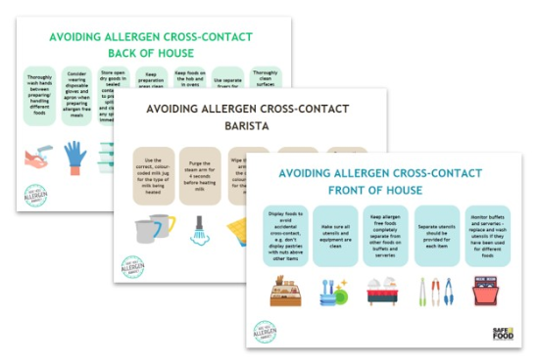
ALLERGEN MANAGEMENT
Training Material and Posters
Know Your Allergens
Food Safety Conversations
Back of House
Front of House
Beverage service
Cross-Contact Posters
Back of House
Front of House
Barista

Slide 17
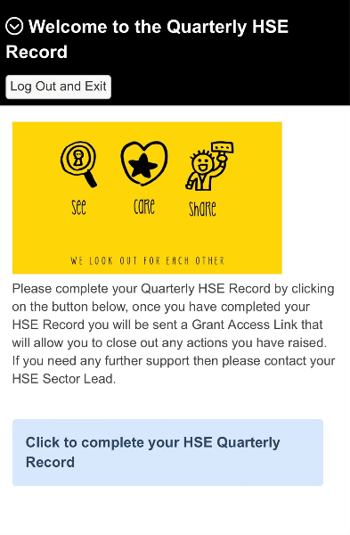
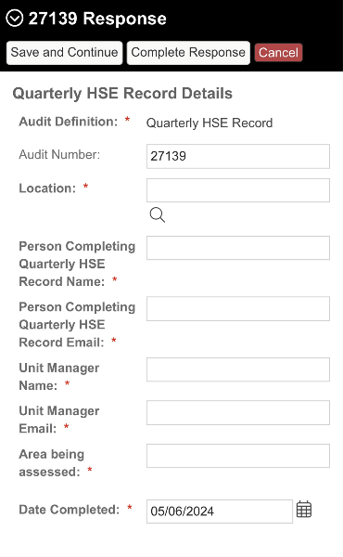
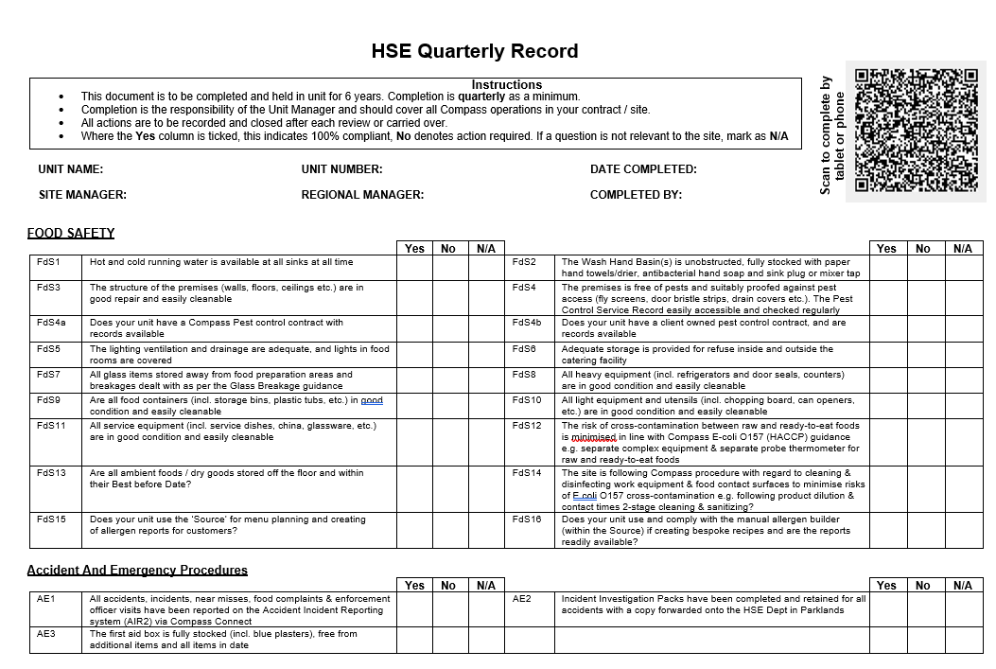
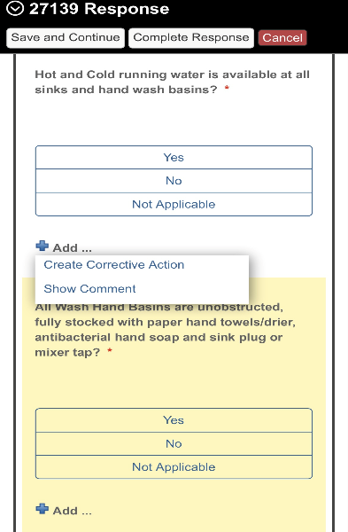
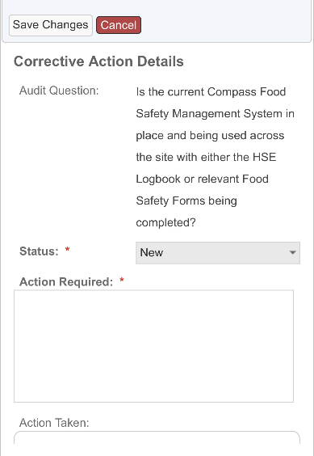
CONTINUOUS IMPROVEMENT
1st Tier Auditing
HSE Quarterly Record
Self-assessment covering H&S, Food Safety, Environment and Quality to be completed by the manager
Online via AIR3, via QR code or hardcopy – logbook or download and print
Answer honestly and accurately
Actions raised on the Action Plan must be closed out within a reasonable timeframe
Guidance document available on the Compass HSE website
2nd Tier Auditing
Internal auditing programme
3rd Tier Auditing
External auditing programme

Slide 18
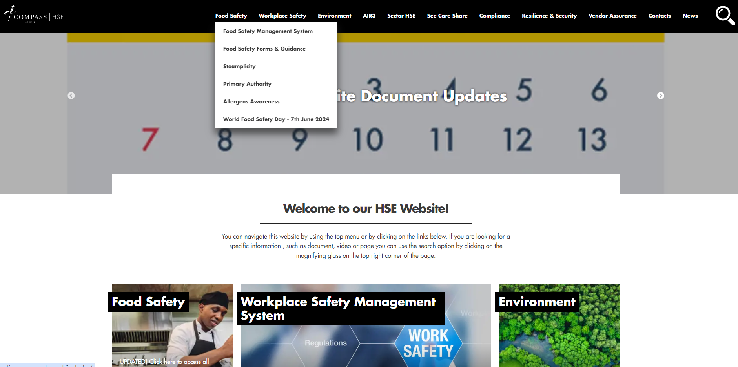
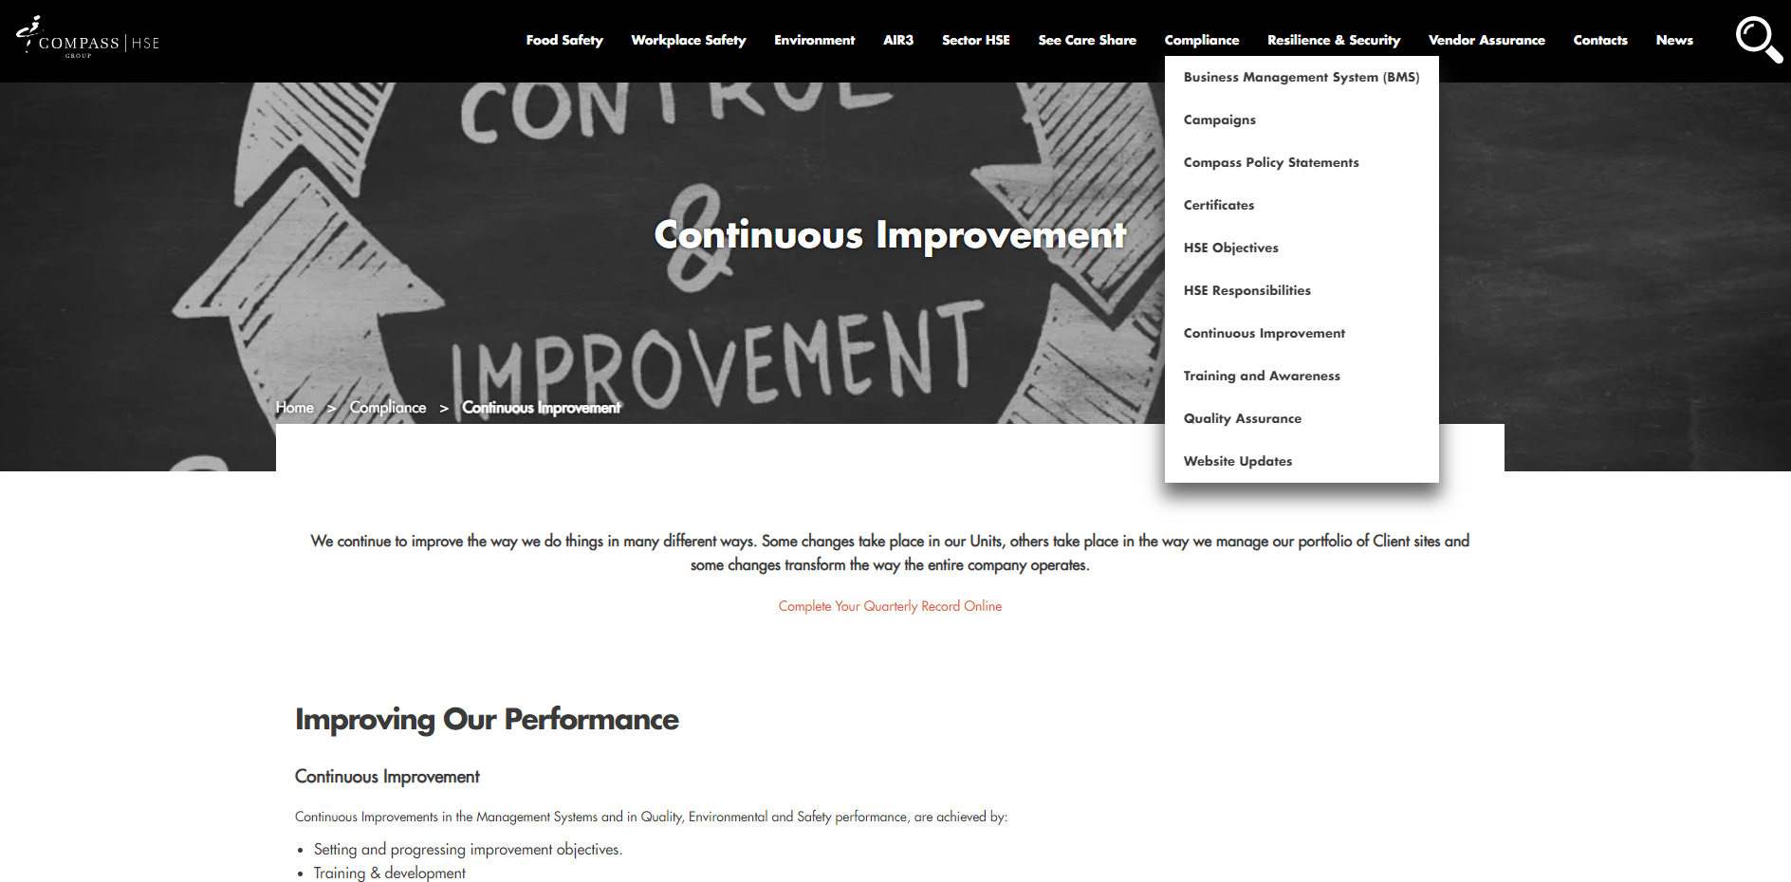
COMPASS HSE WEBSITE
FSMS – HACCP,GHPs, FSCs, Posters
Forms and Guidance
Allergens Awareness
Continuous Improvement – Quarterly HSE Record
Training and Awareness – Safety conversations, Safety Shares
Food Safety
Compliance

Slide 19
COMPASS HSE WEBSITE
Under Workplace Safety
– T: Temporary and Agency Workers Guidance and Induction documents
Contacts
Contacts – PPE catalogue
Safety A-Z

Slide 20
LINNEY MYSTORE
Accounts have been set up for all units
Log into your account
Go to main page
Select Health & Safety
Allergens – folders, posters etc
Food Safety – FSMS, posters
Labels – Food labels
Logbooks - 5 & 7 day

Slide 21
LINNEY MYSTORE
Allergens
Food Safety
Labels
Logbooks

