Slide 1
Workplace Safety Management System
WE LOOK OUT FOR EACH OTHER
Site Safety Information
Unit Name:
Unit Address:
Unit Number:
Unit Name
Unit Address
Unit Number

Slide 2
Compass UK & Ireland
Workplace Safety Management System
Introduction
Welcome to the Site Safety Information pack
The purpose of this pack is to ensure that the hazards and risks identified, and control measures in place, specific to your unit or business operation as detailed in your Essential Risk Assessments are brought to the attention of all individuals who may be affected by those hazards and risks.
This pack includes specific information in relation to the control measures and safety arrangements in place which individuals must follow to ensure their own and others’ safety.
Please refer to the completion guide within your Workplace Safety Management System Folder
for detailed information on how to complete this Information Pack and train individuals.
Communication
This behaviour is about a positive two-way dialogue about safety. In the workplace this would be expressing safety concerns to your supervisor or manager.
SPEAK OUT
Risk Assessment
This behaviour focuses on the hazards in the workplace and how we control them. This is as simple as taking the time to plan how to do the job safely.
STEP 1
STEP 2
STEP 3
BE MINDFUL
Before you deliver the pack to individuals, work through this pack, familiarising yourself with the contents, and complete any sections
where required, to ensure
it is specific to your unit.
Deliver the entire contents of this pack to all individuals. Work methodically through each page. This pack
should be completed in full and should not be delivered across several training sessions.
Once you are happy that individuals have understood the contents of this pack, sign the completion record on their individual WSMS Training Card and file safely for reference.
Involvement
Finally this behaviour is about being proactive to help keep safety front of mind. We can do this within the workplace by sharing our safety knowledge with others.
GET INVOLVED

Slide 3
Compass UK & Ireland
Workplace Safety Management System
Contents
Site Safety Information pack
Workplace Environment Hazards | STCSSI 00 |  | Manual Handling | STCSSI 12
Fire Safety – Good Practice | STCSSI 01 |  | Working with Chemicals | STCSSI 13
Fire Safety – Emergency Procedures | STCSSI 02 |  | Use of Personal Protective Equipment (PPE) | STCSSI 14
Fire Safety – Fire Extinguishers (correct selection) | STCSSI 03 |  | Electrical Safety | STCSSI 15
Fire Safety – Fire Extinguishers (correct use) | STCSSI 04 |  | Use of Gas Appliances | STCSSI 16
Fire Safety – Fire Blankets (hot oil fires) | STCSSI 05 |  | Use of Work Equipment | STCSSI 17
Fire Safety – Fire Blankets (clothes fires) | STCSSI 06 |  | Display Screen Equipment (DSE) | STCSSI 18
Fire Safety – Fire Suppression Equipment | STCSSI 07 |  | New and Expectant Mothers | STCSSI 19
First Aid Arrangements | STCSSI 08 |  | Young Persons in the Workplace | STCSSI 20
Reporting Accidents, Incidents and Near Misses | STCSSI 09 |  | Lone Working | STCSSI 21
Slips, Trips and Falls | STCSSI 10 |  | Workplace Stress | STCSSI 22
Safety Signage | STCSSI 11 |  | Driving on Company Business | STCSSI 23

Slide 4
Workplace Environment Hazards
Compass UK & Ireland
Workplace Safety Management System
STCSSI 00
Creating a positive health and safety culture in the workplace begins with employers ensuring individuals are provided with a safe environment to work in which ensures their health, safety and welfare. Poorly designed and maintained workplaces create hazards and risk to individuals and can lead to a significant increase in accident and incident rates as well as potentially affecting an individual’s health and mental wellbeing.
Do your bit to contribute to keeping your workplace clean and tidy.
Report general workplace hazards, faulty equipment and facilities to the relevant person on site.
TEMPERATURE
A normal working temperature should offer reasonable comfort. Where this cannot be achieved, for example, in storage chillers, or outdoors in hot weather, then other factors must be considered, such as providing hot or
cold drinks, warm clothing, heaters or fans, rest periods
to limit exposure, PPE and adequate training.
MAINTENANCE
Any equipment, tools or machinery that are used by individuals, or are present in the workplace, must be well maintained and where applicable inspected and serviced at periodic intervals to ensure their safety.
TOILETS
There should be an appropriate number of toilets and sanitary conveniences available, including disabled facilities. Separate male and female toilets are not required if the workplace is small and the toilets are fully lockable.
CLEANLINESS
Good hygiene should be maintained at all times, so waste should be regularly disposed of and cleaning should be routine.
VENTILATION
All working environments must have a sufficient supply of fresh air, either via a mechanical ventilation or air conditioning system, or by simply opening windows or doors.
LIGHTING
Adequate lighting must be provided to ensure all areas of the workplace are well lit. This reduces the likelihood of slips, trips and falls and individual issues such as eye strain.
REST FACILITIES
An area should be provided for individuals to take their breaks and eat meals. This area should be clean and free from any work-related contaminants.
WASHING FACILITIES
Adequate washing facilities should be provided, with soap, hand drying facilities and warm and cold water. If the nature of the work
is especially physical, or there is a risk of individuals coming into
contact with contaminants such as bodily fluids or hazardous chemicals, showering
facilities should also be made available.
DRINKING WATER
Clean, fresh drinking water should be available to all staff. If there are drinking and non- drinking water supplies, the drinking water should be clearly marked.
CHANGING ROOMS
If individuals are required to change into a uniform or PPE to carry out their job, a private area for changing should
be provided.
WS.STC.SSI.00.01

Slide 5
Fire Safety – Good Practice
Compass UK & Ireland
Workplace Safety Management System
STCSSI 01
Fire poses a risk in every workplace so it is important that everyone understands their responsibilities to ensure safety measures are in place and procedures are followed to prevent a fire from starting.
Fires need three things to start:
1. A source of ignition (heat)
2. A source of fuel (something that burns)
3. A source of oxygen
Sources of ignition include heaters, lighting, naked flames, electrical equipment, smokers’ materials (cigarettes, matches etc), and anything else that can get very hot or cause sparks.
Sources of fuel include wood, paper, plastic, rubber or foam, some chemicals, loose packaging materials, waste rubbish and furniture.
Air is the main source of oxygen.
Heaters and lighting must never be placed close to combustible items.
Cooking and electrical equipment should be
turned off when not in use.
Electrical equipment should be inspected regularly for signs of wear or damage.
Smoking is prohibited in the workplace and you should only smoke in the designated external locations provided.
Any equipment which gets hot should be
allowed to cool before storing away.
Rubbish and litter must be disposed of frequently and properly outside the building.
Where site access is not secure, external bin
lids may be kept locked to prevent arson.
Doorways, passages, corridors, stairs and escape routes must be kept clear at all times and waste products should not be allowed to build up.
Flammable items must never be stored close to heat sources and should be stored in accordance with manufacturers’ instructions.
Fire doors must never be propped open.
Some fire doors may be locked for security reasons when the building is unoccupied.
Fire doors must be unlocked at all times when individuals are in the building.
In the event of an emergency evacuation, close windows and doors as you evacuate (if it is safe to do so).
Ventilation equipment should be switched off when not in use.
WS.STC.SSI.01.01

Slide 6
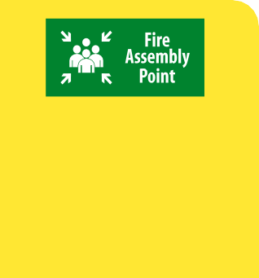
Fire Safety – Emergency Procedures
Compass UK & Ireland
Workplace Safety Management System
STCSSI 02
It is important that you understand what to do in the event of an emergency situation. Your workplace will have a specific fire evacuation procedure to follow. Your line manager will explain this to you.
In addition to understanding the fire evacuation procedure, your line manager must ensure you also understand the following:
Your local fire wardens are:
The location of all fire alarm call points and how to raise the alarm should you discover a fire.
The location of all available emergency exits and where they lead to.
The location of your fire assembly point and who to report to once you arrive.
What the fire alarm sounds like and any times when an audibility test is carried out on the fire alarm system.
Your fire assembly point is:
Some individuals may have difficulty hearing the fire alarm or evacuating swiftly from the building. Discuss any concerns you have with your line manager. If required they can create a Personal Emergency Evacuation Plan (PEEP) for you which will ensure your safety.
Upon arrival you report into:
Hearing Impairment
Visual Impairment
Mobility Impairment
Short-Term Injury
WS.STC.SSI.02.01

Slide 7
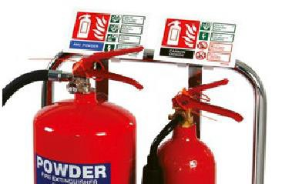
Fire Safety – Fire Extinguishers (correct selection)
Compass UK & Ireland
Workplace Safety Management System
STCSSI 03
Fire fighting equipment should only be used by trained personnel (fire wardens) unless your immediate safety is compromised. In case of such an emergency, you will need to know how to select the correct type of extinguisher:
Signage is displayed alongside each fire extinguisher. This gives information on what type of fire the extinguisher should and should not be used on.
WATER
For use on wood, paper, fabrics etc.
 | DO NOT use on electrical or flammable liquid fires
FOAM
For use on flammable liquids, oils, fats, spirits etc.
 | DO NOT use on electrical fires
POWDER
For use on most fires (including electrical and flammable liquids).
 | DO NOT use on cooking oil fires
CO₂
For use on electrical and flammable liquid fires.
 | DO NOT operate in confined space where there is a danger of fumes being inhaled
WET CHEMICAL
Specifically for use on fires in deep fat fryers.
 | DO NOT use on LIVE electrical equipment
If a fire extinguisher appears to be damaged or if it is missing from its location, report this to the relevant person in your workplace.
Fire extinguishers should be located in areas where there is a risk of fire and also near to the exits in your working area.
Make sure you know the locations of all
the fire extinguishers in your workplace.
WS.STC.SSI.03.01

Slide 8
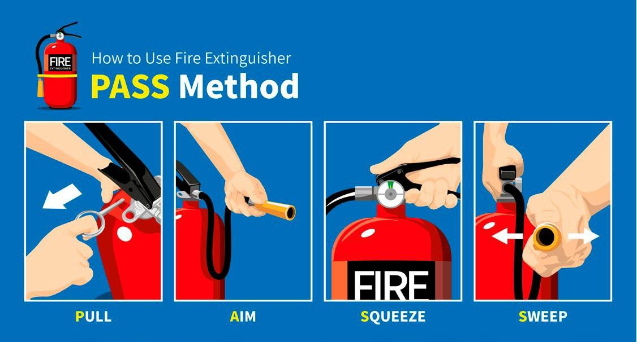
Compass UK & Ireland
Workplace Safety Management System
Fire Safety – Fire Extinguishers (correct use)
STCSSI 04
Once you have selected the correct fire extinguisher, follow the PASS rule to operate. Fire extinguishers are designed for use on small fires and will usually fully extinguish such a fire within approximately 30 to 90 seconds.
1 P
2 A
3 S
4 S
Pull the pin
Aim the nozzle
Squeeze the lever
Sweep side to side
Caution: Fire extinguishers can be heavy. If this is an issue, once you have selected the correct extinguisher, place it on the floor at a safe distance from the fire before following the PASS operating method.
WS.STC.SSI.04.01

Slide 9
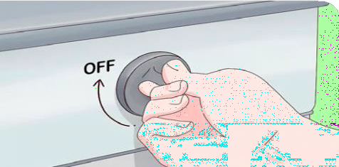
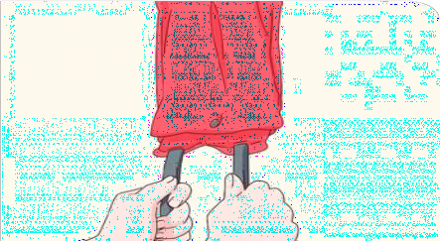
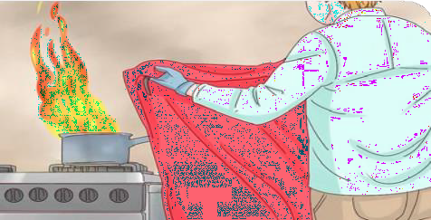
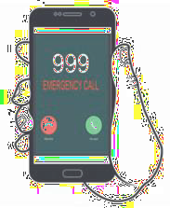
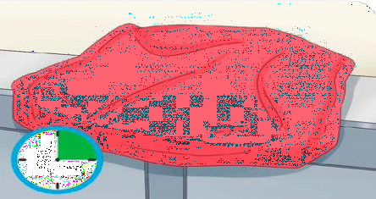
Fire Safety – Fire Blankets (hot oil fires)
Compass UK & Ireland
Workplace Safety Management System
STCSSI 05
Fire blankets are located in kitchens where cooking with hot oils or naked flames takes place. Fire blankets are used to extinguish hot oil fires. Remember, some cooking equipment may have a fire suppression system, thus eliminating the need for manual intervention. Your line manager will advise you if there is a fire suppression system in place.
To use a fire blanket in the event of a hot oil fire:
1
2
3
Make sure you know where all fire blankets are located.
If a fire blanket is missing from its location or appears to be damaged, report to the relevant person in your workplace.
Turn off the heat source.
Remove the fire blanket from its container by pulling down sharply on the tabs, and open out the blanket.
Shield yourself from the fire by holding the fire
blanket at arms’ length in front of you. Roll the corners of the blanket over your hands to protect them.
Place the blanket over the fire. Do not throw it, but lay it down gently. Start with the nearside of the flames and lay the blanket away from you. NEVER throw the blanket across the fire, this can cause the flames to creep up over the blanket, worsening the situation.
4
5
Do not use a fire blanket on a deep fat fryer; in this circumstance a wet chemical fire extinguisher should be used.
Call the emergency services. Even if you have extinguished the fire you will need to make sure there is no chance of lingering embers or heat which could cause another fire.
Leave the blanket at the heat source until the flame is suffocated. This should take about 15 minutes. Do not attempt to move or touch the blanket until it’s cool again.
Images courtesy of wikiHow.com from the article
https://www.wikihow.com/Use-a-Fire-Blanket
WS.STC.SSI.05.01

Slide 10
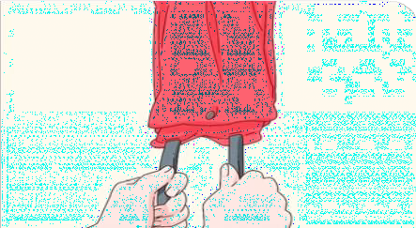
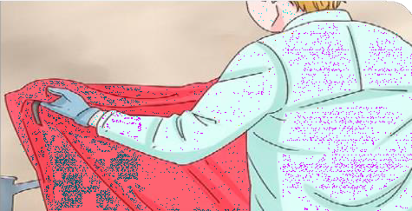
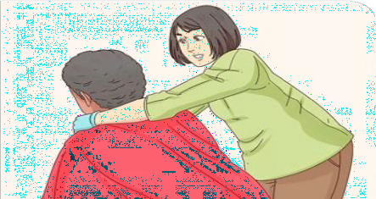
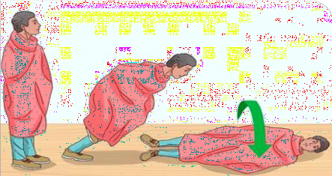
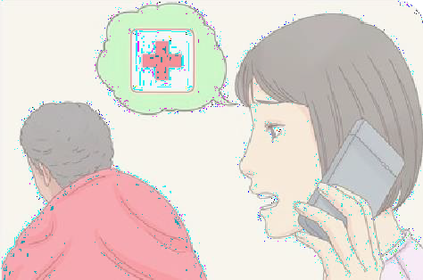
Fire Safety – Fire Blankets (clothes fires)
Compass UK & Ireland
Workplace Safety Management System
STCSSI 06
Fire blankets can also be used to extinguish flames on an individual.
To use a fire blanket in the event of a clothes fire:
1
2
3
Remember
You must never put your own safety at risk. Make sure you know the locations of all emergency exits,
fire-fighting equipment and any gas shut-off points.
Remove the fire blanket from its container by pulling down sharply on the tabs, and open out the blanket.
Shield yourself from the flames by rolling the corners of the blanket over your hands to protect them.
Wrap the fire blanket tightly around the individual to smother the fire. Take care to protect yourself from burns.
4
5
999/
112
STOP, DROP, ROLL
Instruct the individual to drop to the floor and roll in the blanket until the fire is suffocated.
Seek medical assistance immediately. Burns caused by fire should be evaluated by a medical professional as soon as possible, even if you think the burns look minor.
Images courtesy of wikiHow.com from the article https://www.wikihow.com/Use-a-Fire-Blanket
WS.STC.SSI.06.01a

Slide 11
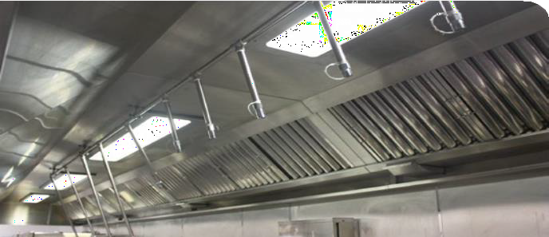
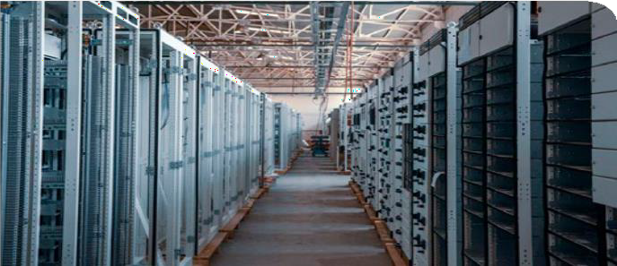
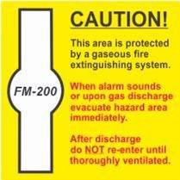
Fire Safety – Fire Suppression Equipment
Compass UK & Ireland
Workplace Safety Management System
STCSSI 07
In addition to fire extinguishers and fire blankets, some work equipment or locations may also have additional fire safety devices known as fire suppression equipment.
Signage is displayed to warn where data room fire suppression systems are present
Where there is an increased risk of fire present, some cooking appliances (those with naked flames or hot oil vessels) may have a fire suppression system fitted. This system may activate should a fire break out. It works by releasing a fire extinguishing chemical from above to extinguish the fire (usually within the canopy hood). If this system is present your line manager will advise and explain its function to you.
You may also find fire suppression systems present in data rooms. These systems are designed to detect a fire and release a gas to extinguish the fire, preserving
data equipment. The main point to remember with these systems is that they should be deactivated before an individual enters the data room. This is due to the gas which is emitted in the event of a fire, removing oxygen from the room. Only individuals who have been trained in these suppression systems should be allowed to enter any areas where it is present.
WS.STC.SSI.07.01

Slide 12
First Aid Arrangements
Compass UK & Ireland
Workplace Safety Management System
STCSSI 08
If you become ill or sustain an injury in your workplace, you may need to summon the assistance of a first aider, so it’s important that you know who your first aider is, and where first aid kits, defibrillators and any first aid rooms which are available are located.
Your first aiders are:
First aid kits, defibrillators and first aid rooms are located:
Your nearest hospital with Accident and Emergency is:
Medical conditions
and prescribed medicines
To call for an ambulance in an emergency dial 999/112 from a landline or mobile telephone.
In the UK call 111 from a landline or mobile phone for non-emergency
advice.
If you have a medical condition or currently take any prescribed medicines, and feel that it would be beneficial to share this information with a local first aider or colleague, please speak with your line manager.
WS.STC.SSI.08.01a

Slide 13
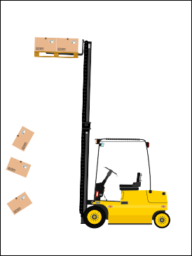
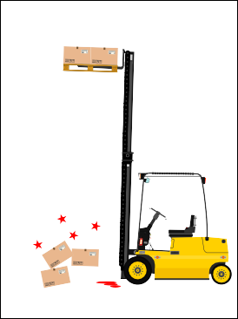
Reporting Accidents, Incidents and Near Misses
Compass UK & Ireland
Workplace Safety Management System
STCSSI 09
You have a legal duty to report to your employer all accidents and incidents, however trivial, which occur during working hours, regardless of whether they occur on or off site. Your line manager will upload the incident to the AIR3 reporting system and will carry out an incident investigation with you.
Hazard spotting and reporting near misses
UNSAFE CONDITION | A condition in the workplace which, if unnoticed or ignored, has the potential to cause injury, illness or damage to property.
UNSAFE ACT | The actions of an individual when carrying out a task or other activity in a way that has the potential to cause injury, illness or damage to property.
NEAR MISS | An event which has occurred and had the potential to cause injury, illness or damage to property but didn’t.
ACCIDENT | An event which has occurred and has caused injury, illness or damage to property.
Reporting accidents is an important responsibility, but this is very much a reactive activity. We place a high
importance on reporting and removing hazards before they lead to someone getting hurt.
If you spot a hazard or dangerous situation which you cannot resolve yourself, you must report it as soon as possible. Report any hazards or other issues to your line manager.
Unsafe Condition
Unsafe Act
We treat accidents seriously, not from a culture of blame, but as a means
to understand why they happen and to learn how to prevent them in
the future.
Although accidents during business travel (such as driving) are required to be reported to insurers, you also have a duty to report this as an accident at work.
It is really important that all accidents are reported promptly, and this must be done as soon as possible.
Near Miss
Accident
WS.STC.SSI.09.01

Slide 14
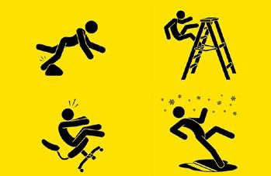
Compass UK & Ireland
Workplace Safety Management System
Slips, Trips and Falls
STCSSI 10
Slip, trip and fall potential:
ENVIRONMENT
Bright lighting and sun reflection can cause glare on smooth or shiny
flooring and stop people from seeing
hazards. Poorly lit areas such as corridors and stairways will also prevent people from seeing hazards. Rainwater walked in at the entrance to a building can cause slip hazards. Winter conditions will also create slip hazards when snow and ice
are present.
FOOTWEAR
Footwear must be suitable for your working environment. If you have been provided with safety footwear you must wear it! If you have any concerns with suitability of footwear, discuss with your line manager.
CLEANING
Wet floors from mopping, and trailing cables from vacuums, can cause slip and trip hazards. Timings of when these work activities are carried out must be considered and safety signage displayed to warn others of the potential hazards.
Did you know?
CONTAMINATION
People rarely slip on a clean, dry floor. Contamination is involved in almost all slip accidents, that is anything
that ends up on a floor, such as rain water, oil, dust. If a floor has a smooth surface, even a tiny amount of contamination can be a real slip problem. Care must be taken when selecting floor cleaning products.
Some can leave a residue which will cause slip hazards.
FLOORING
Worn, poorly maintained or raised floor coverings and matting, uneven or broken tiles, slabs
and concrete, changes in floor surface level, narrow staircase
footings, lack of warning signage and incorrect selection of flooring type will cause slip, trip and fall hazards. If you spot any damage or potential hazards, report them to your line manager.
UK Health and Safety Executive statistics show slipping and tripping to be the single most common cause of major injury in UK workplaces. The Health and Safety Authority in Ireland attributes a quarter of all reportable injuries to slips, trips and falls, with slipping and tripping on the same level accounting for 81% of this statistic.
Slips and trips are often the initiators of accidents attributed to other causes, such as some machinery accidents, scalding and falls from height.
PEOPLE
Human behaviours can create hazards in the workplace. Items placed in walkways, build-up of waste, fallen debris, wet floors, spillages and rushing can all contribute to slips, trips and falls. Don’t walk on by, deal with hazards when you spot them.
“Spot a hazard and can’t sort it? – REPORT IT!”
WS.STC.SSI.10.01a

Slide 15
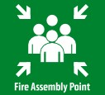
Safety Signage
Compass UK & Ireland
Workplace Safety Management System
STCSSI 11
Safety signs can be a vital control in safeguarding individuals. All health and safety signage used in the workplace must comply with the Safety Signs and Signals Regulations 1996 in the UK and the Health and Welfare at Work (General Application) Regulations 2007 in Ireland and should fall into one of the below four categories:
PROHIBITION
(“You must not…”)
MANDATORY
(“You must…”)
WARNING
(“Take care, or be careful of…”)
SAFE CONDITION
(“In an emergency here is the…”)
Usually red on a white background or just red signage with black picture (usually with a red line through
the picture), which will identify pictorially what you MUST NOT DO
Usually blue on a white background or just blue signage with white picture which will identify pictorially what you MUST DO
Usually yellow on a white background or just yellow with black picture which will WARN you pictorially of a hazard or danger
Usually green on a white background or just green with white picture which will identify pictorially a SAFE CONDITION
No pedestrians
No smoking
Hi visibility vest must be worn
Fire door Keep shut
Caution wet floor/ slippery surface
Danger high voltage electricity
Defibrillator
Fire assembly point
DON’T
DO
WATCH OUT
YOUR SAFETY
WS.STC.SSI.11.01a

Slide 16
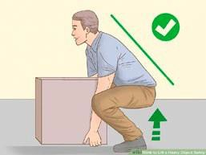
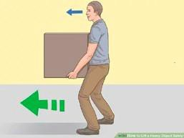
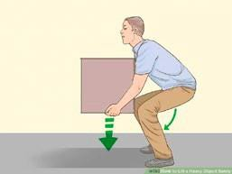
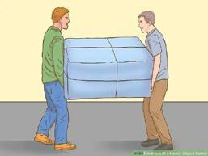
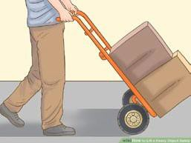
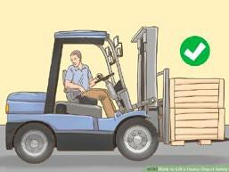
Manual Handling
Compass UK & Ireland
Workplace Safety Management System
STCSSI 12
Did you know? – One in three accidents at work is caused by manual handling, with many accidents resulting in musculo-skeletal injuries. Every year 300,000 people in the UK suffer from back pain due to manual handling accidents. In Ireland manual handling is the leading cause of reportable incidents.
Always assess the risks before carrying out the task!
Conduct a manual handling risk assessment
T
TASK
Consider the activity itself, i.e. the lifting, lowering, carrying, pushing or pulling. Does the task involve repetitive movements, strenuous movements, long distances, or uneven weight distribution?
Ensure you have the correct manual handling training
Use mechanical aids wherever possible
I
INDIVIDUAL
Consider your capabilities before carrying out the manual handling activity. For example, how strong, fit or able are you? Are you capable of manual handling alone? Do you need assistance?
Plan the route before you start
Bend knees, back straight.
Hug the load, head up.
Work from a stable base
LOAD
Consider the object or person that is being moved and look at how this may affect health and safety. For example, is the load particularly heavy, bulky, hard to grasp or unstable?
Hug the load when carrying
L
Bend your knees when lifting and lowering
Avoid twisting or leaning
E
ENVIRONMENT
Consider the area and look at how this could make the manual handling task unsafe. Is the floor slippery or uneven? Are there slopes? Is there sufficient lighting? Are there any trip hazards?
Keep your head up
Lower gently, do not stoop.
Get help when required.
Know your limits
O
OTHER FACTORS
Are there any other factors which need to be considered? Is any Personal Protective Equipment (PPE) required?
Push a load rather than pull it
If you carry out significant manual handling activities within your role, you will be provided with additional in-depth manual handling training. Speak to your line manager if you have any specific concerns.
Use mechanical aids wherever possible.
WS.STC.SSI.12.01a

Slide 17
Working with Chemicals
Compass UK & Ireland
Workplace Safety Management System
STCSSI 13
In order to work safely with chemicals, you must be aware of what they are, how they can cause harm and the safety guidelines for their use. If you use chemicals or are exposed to chemicals within your workplace, your line manager will ensure you have received the necessary training and information.
What do the chemical hazard symbols mean?
Dangerous to the | Toxic | Gas under
environment |  | pressure
Corrosive | Explosive | Flammable
Caution – used | Oxidising | Longer-term
for less serious |  | health hazards
health hazards like |  | such as cancers
skin irritation
The 10 Golden Rules for Working with Chemicals
1
Only use chemicals if you have been trained to use them. Your line manager will ensure you receive the required training.
2
Be sure you can read the labels and follow the instructions for use. Never guess what chemical is in the container.
3
Always follow the safety rules and safe working practices in the
workplace. Always use chemicals in accordance with manufacturers’ advice.
4
Be sure you know what first aid treatment is required if you or anyone else
comes into contact with chemicals.
5
Use the recommended Personal Protective Equipment (PPE). It is provided to you to keep you safe! Do not use damaged or faulty PPE.
6
Dilute chemicals according to manufacturers’ recommendation. Never change dilution rates as the concentration may become harmful.
7
Do not mix chemicals. Some chemicals when mixed can react, causing explosions, toxic fumes and corrosive solutions.
8
Never put chemicals into or use chemicals in unmarked containers. This is dangerous
for anyone who attempts to use an unknown product.
9
Never put chemicals into bottles or
containers that have other uses, for example, eating or drinking. Residue can be harmful to health if ingested.
10
Report any damaged containers, spills or faulty containers or dispensers
to your line manager. Safety is everyone’s responsibility!
WS.STC.SSI.13.01a

Slide 18
Use of Personal Protective Equipment (PPE)
Compass UK & Ireland
Workplace Safety Management System
STCSSI 14
Even where control measures are in place to reduce risk, and safe systems of work have been applied to work tasks, some hazards may still remain. If PPE is still needed after implementing other controls, then your line manager will issue this to you and train you to use it correctly.
If you use PPE you must:
When and why should I use PPE?
Ensure PPE fits correctly
Keep PPE clean, in good condition and store it correctly
Not share PPE with others
Make sure that if more than one item of PPE is worn at the same time, they can be used together. For example, wearing safety glasses may disturb the seal of a respirator, causing air leaks
Ensure single-use PPE is used only once and disposed of correctly
Select the correct PPE for the task
Only use PPE which is certified with the current CE mark
Not use damaged or faulty PPE
Eye Protection
Protects from flying particles, contact with
chemicals, fluid under pressure.
Head Protection
Protects head from impacts.
Respiratory Protection
Prevents inhalation of potentially hazardous substances such as dust or chemical vapours.
Hearing Protection
Protects from excessive noise.
Body Protection
Protects from temperature extremes, hot splashes, potential impacts and hazardous materials.
Hand Protection
Prevents cuts, slivers, punctures, chemical exposures, exposure to heat and cold, electricity and biological hazards.
Foot Protection
Protects from impact from falling or rolling objects, punctures from stepping on sharp objects, electricity, slippery or uneven surfaces.
Fall Protection
Protects individual from falls from height.
WS.STC.SSI.14.01

Slide 19
Electrical Safety
Compass UK & Ireland
Workplace Safety Management System
STCSSI 15
Electricity can kill or severely injure people and cause damage to property. However, you can take simple precautions when working with or near electricity and electrical equipment to significantly reduce the risk of injury to you and others around you.
What are the hazards?
Before using any portable electrical equipment the user must check the item for:
The main hazards of working with electricity are:
Damage (apart from light scuffing) to the supply cable, including fraying or cuts
Damage to the plug or connector, such as the casing cracking, or the pins being bent
Inadequate joints, including taped joints in the cable
The outer sheath of the cable not being effectively secured where it enters the plug or the equipment. Evidence would be if the coloured insulation of the internal cable cores were showing
The equipment having been subjected to conditions for which it is not suitable, for example it is wet or excessively contaminated
Damage to the external casing of the equipment
Loose parts or screws
Evidence of overheating (burn marks or discolouration)
Electric shock and burns from contact with live parts.
Injury from exposure to arcing, fire from faulty electrical equipment or installations.
Explosion caused by unsuitable electrical apparatus or static electricity igniting flammable vapours or dusts.
Electric shocks can also lead to other types of injury, for example by causing a fall from ladders or scaffolds etc.
These checks also apply to extension leads, plugs and sockets.
Never overload plug sockets or ‘daisy chain’ extension leads
Store electrical items correctly
Use electrical appliances only for their intended use
Never attempt to repair electrical equipment
Remember:
All portable electrical
equipment must display a current
(in-date) PAT test sticker!
Check plugs, leads, connection points and plug sockets for damage
Wrapping cables around appliances can damage them. Items should not be exposed to moisture
Items should only be used in accordance with manufacturers’ guidance
Always report defects to ensure a competent person repairs equipment
WS.STC.SSI.15.01

Slide 20
Use of Gas Appliances
Compass UK & Ireland
Workplace Safety Management System
STCSSI 16
Gas can kill or severely injure people and cause damage to property. If gas appliances, such as ovens, cookers and boilers, are not properly installed and maintained, there is a danger of fire, explosion, gas leaks and carbon monoxide (CO) poisoning.
Gas appliances can only be maintained and serviced by someone who is a Gas Safe registered engineer (UK) or Registered Gas Installer (ROI). It is illegal for an unregistered person to carry out work on any domestic gas appliance.
You must never attempt to carry out repairs or modifications to any gas equipment. Always report defects to ensure a competent person repairs equipment.
Taking simple precautions when working with, or near, gas equipment will significantly reduce the risk of injury to you and others around you.
Safe use of LPG Gas Bottles
Check for any obvious signs of damage to the pipes or fittings. If in doubt consult a Gas Safe registered engineer for advice.
Follow the manufacturer’s instructions and the instructions on the gas canister.
Make sure the tap is turned off before changing
the gas cylinder.
Change cylinders outdoors if possible or in a well ventilated area.
If you suspect a leak to the cylinder or pipe work, do not use and report it to the relevant person.
Ensure the gas bottle is upright at all times.
Ensure equipment carries a British Standard Kite
Mark or European C.E mark.
You must only use gas appliances if you have been trained
Ensure you know the location of the main gas
isolation button in case of emergency
Check gas equipment before use
Check controls, ignition switches and connections and look at the general condition of equipment and any visible pipework/ hoses for damage.
If you suspect a gas leak report it immediately
Report to the relevant person on site. Open doors and windows where possible, do not switch any electrical equipment or lighting on or off and evacuate the area.
Never leave gas equipment switched on
unattended
Only light gas equipment with the ignition switch supplied
If there is no ignition switch then a long-handled taper should be used
Always switch off gas equipment at the end of the shift
NEVER blow out the flame, always turn off at the controls
If you are involved in the connection of single LPG bottles to a piece of equipment such as a BBQ then you should complete an online safe use of LPG course. All other types of LPG connections for events should be completed by a GAS SAFE Engineer.
Do not store sources of fuel or combustibles near to naked flames
Gas bottles must be kept in a locked outdoor store away from the main building with a sign indicating No smoking or naked flames.
WS.STC.SSI.16.01a

Slide 21
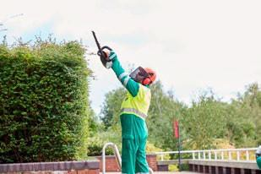
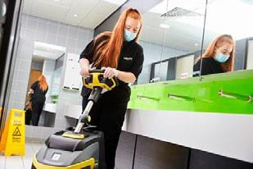
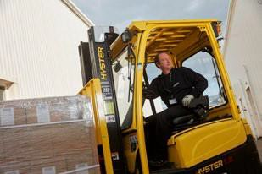
Use of Work Equipment
Compass UK & Ireland
Workplace Safety Management System
STCSSI 17
There are many different types of work equipment and it is likely that you will be required to use such equipment as is relevant to your role. If so, your line manager will identify all equipment you are expected to use and where its use poses a significant risk to safety, will ensure you are trained to use it safely, without risk to yourself or others.
What you must do to ensure equipment is used safely
Only use equipment if you have been trained to do so and in line with any manufacturers’ instructions
Inspect equipment before use (pre-use checks)
Store equipment correctly and safely when not in use
Report all defects
All defects must be reported to the relevant individual and equipment labelled to identify it. It should not be used and should be removed from use (or from the location where it is likely to be used) until it is repaired or replaced.
Pre-use checks should be undertaken by the operative to ensure the work equipment is safe to use. Checks should focus on the condition of the equipment, checking for any damage or deterioration, particularly focusing on parts of the equipment necessary
for its safe operation, such as on-off switches, cables, any structural parts and any charging accessories required.
Equipment must be stored securely, in a suitable location, to ensure that
it does not pose a risk to others and is not susceptible
to damage. Care should be taken when storing electrical equipment to ensure it will not come into contact with water. If
charging equipment is used, cables must not present
trip hazards. Charging devices must only be used
for the intended piece of
work equipment.
Make sure you are confident you know how to use the equipment safely and if large, heavy, or awkward, that it is within your physical capabilities. If you have any concerns, do not use the equipment and speak with your line manager.
WS.STC.SSI.17.01

Slide 22
Display Screen Equipment (DSE)
Compass UK & Ireland
Workplace Safety Management System
STCSSI 18
Incorrect use of DSE or poorly designed workstations or work environments can lead to pain in the neck, shoulders, back, arms, wrists and hands as well as contributing to fatigue, headaches and eye strain.
What is DSE?
Question | Answer | Answer Score | Your Score
1. If necessary, could you adequately complete your daily tasks, without using DSE? | Yes | 0
 | No | 3
2. On an average day, what is the maximum length of time you would continuously use DSE, without having a break or doing something else? | 0 – 1hour | 0
 | 1– 2 hours | 3
 | 2 – 3 hours | 4
 | 3 + hours | 5
3. On average, how many days a week would you use DSE continually for a period of one hour or more? | 1day | 1
 | 2 days | 2
 | 3 days | 3
 | 4 days | 4
 | 5 + days | 5
Your Score
DSE refers to any alphanumeric or graphic display screen, regardless of the display process involved. It covers PCs, laptops, tablets and smartphones as well as other methods of displaying data, such as cash registers and CCTV screens.
If your total score is less than 7 you are not a defined DSE User.
Am I a DSE User?
If your total score is 7 or higher you are a defined DSE User and you must complete the relevant online DSE Training and Risk Assessment which can be found on the HSE web page.
If you use DSE as a significant part of your normal work then it is likely you are a
DSE User. We define this as ‘individuals who use DSE daily, for continuous periods of an hour or more’. Use the table provided on this page
to determine if you are a
DSE User.
DSE Risk Awareness
Training and Self Assessment for Home Workers
DSE Risk Awareness
Training and Self Assessment for Workers On The Go
DSE Risk Awareness
Training and Self Assessment for Office Workers
Internal
Internal
Internal
WS.STC.SSI.18.01

Slide 23
New and Expectant Mothers
Compass UK & Ireland
Workplace Safety Management System
STCSSI 19
If you are currently pregnant, have given birth in the last six months or are breastfeeding, then you are a new or expectant mother. It is important to inform your employer as soon as possible to ensure the health and safety of both you and your child whilst you are at work.
It is important that you discuss the nature of your working tasks with your line manager at regular intervals both during and after your pregnancy to ensure any necessary adjustments are made and in a timely manner.
You must ensure that all the risks presented to you in relation to your role are identified. This should be documented using the ES10 New and Expectant Mothers Risk Assesssment and should be reviewed as often as you feel is necessary. Remember, things change!
Consider all aspects of your role
Working in | Manual
hot/cold | handling
conditions | tasks
 | Tasks which
Shift work or | require sitting or
lone working | standing for long
 | periods
Suitable | Additional
footwear | uniform
Employers are required by law to:
Provide suitable areas where breastfeeding mothers can express milk and rest.
This should be a hygienic and private area (toilets are not suitable).
A suitable chilled facility to store expressed milk should also be provided. Remember to label your container so it is easily identifiable.
Make sure you advise your line manager of any upcoming medical appointments so they can make arrangements when scheduling work and arranging any cover.
Remember:
We look out for each other!
Don’t be worried about asking a colleague for help.
WS.STC.SSI.19.01

Slide 24
Young Persons in the Workplace
Compass UK & Ireland
Workplace Safety Management System
STCSSI 20
Many young people are likely to be new to the workplace and in some cases will be facing unfamiliar risks relating to their role and surroundings. They must be provided with clear and sufficient instruction, training and supervision to enable them to work safely and without putting others at risk.
Line managers must ensure:
If you are responsible for supervising a young worker you must:
Give them a tour of the workplace and explain to them any risks or hazards present.
A risk assessment has been completed in relation to the young person.
Young persons are given information and
understand all site safety procedures.
Young persons have been given sufficient training to carry out their tasks.
Young persons only carry out low-level risk activities.
Consideration is given to their age, experience,
maturity and physical capabilities.
Show them where the first aid kits are located and introduce them to their first aider.
Make sure they know where all the emergency exits are, the location of the fire assembly point and who the fire wardens are.
Ensure they know what to do in the event of an emergency and escort them during an emergency evacuation.
Advise them on how to report hazards such as wet floors or trip hazards.
Ensure they are wearing suitable footwear and clothing for the environment they are working in.
Supervise them when using equipment which poses a risk to their safety.
Note: No one under the age of 18 is permitted to drive on company
business or drive a company vehicle.
Ensure they have the correct PPE for their tasks.
WS.STC.SSI.20.01

Slide 25
Lone Working
Compass UK & Ireland
Workplace Safety Management System
STCSSI 21
Lone working should be eliminated wherever possible; however, this is not always practical. If you are defined as a lone worker for some or all of your working tasks, your line manager must make the necessary arrangements to ensure you are safe whilst carrying out your role.
Who are lone workers?
You must discuss lone working arrangements with your line manager and they must ensure there are sufficient measures in place to ensure your safety when carrying out any lone working tasks. Arrangements could include:
The Health and Safety Executive (HSE) & Health and Safety Authority (HAS) define a lone worker as:
‘Those who work by themselves without
close or direct supervision.’
Those who work outside normal office hours.
Those remote from a central office.
Those who work in remote areas of an occupied building.
Those remote from emergency services.
Those working from home.
Those who travel as part of their job.
The use of walkie-talkies to stay in regular contact with colleagues.
Regular telephone calls between yourself and a control room or supervisor.
A reliable system in place to ensure a lone worker has returned to their base once they have completed their task.
To determine the necessary arrangements required to ensure your safety whilst carrying out any lone working, your line manager
will complete the Lone Working Risk Assessment and checklist with you.
WS.STC.SSI.21.01a

Slide 26
Workplace Stress
Compass UK & Ireland
Workplace Safety Management System
STCSSI 22
Stress in the workplace can develop due to a number of , or from one single event. It can impact both employees and employers. In the UK and Ireland work-related stress accounts for more than half of all working days lost to ill health.
The Stress Bucket
Pressure in the workplace cannot be avoided completely and can affect us all
at different times and in different ways.
Imagine each individual has a bucket and fills it with water (water being the amount of pressures).
These pressures can be identified in two categories:
Positive Pressures
Motivate individuals.
Give individuals a sense of achievement, for example when a problem is solved, or a tight work deadline is met.
Give individuals confidence in their abilities.
Create positive working relationships and work environments.
Create a healthy work-life balance.
Negative Pressures
Demotivate individuals.
Cause individuals to feel anxious when workloads become demanding or too challenging.
May cause individuals to question their ability,
lose confidence and appear indecisive.
Create negative working relationships and a tense working environment.
When the bucket is full, the water overflows and creates a problem. Everyone’s bucket is
a different size and will dictate how much work pressure they are able to cope with before they become overwhelmed and issues arise.
Think about the size of your bucket and whether all of the water you need to carry will fit without overflowing!
Remember to use the outlet taps to prevent your
bucket overflowing!
Positive pressure can give individuals a feel-good factor and enhance their working performance. They look forward to the day-to-day challenges their role presents.
Negative pressure can lead to mental and physical ill health, absence from work, poor performance and a lack of concentration, which could lead to an accident.
WS.STC.SSI.22.01a

Slide 27
Driving on Company Business
Compass UK & Ireland
Workplace Safety Management System
STCSSI 23
If you carry out any driving as part of your role, including driving between sites, or to run an errand, this is known as driving on company business. Your line manager must ensure you have been included in our company Driver Safety Risk Management programme. If you work in the Republic of Ireland you will need to follow a separate process that will be communicated to you by your HSE Manager.
This applies to driving:
Motorcycles
You will receive an email invitation from our risk management partner, requesting you to log into
their online training portal and upload your driving licence details and, where applicable, vehicle insurance and MOT certificates.
You must also complete the online driver training module and the driver risk assessment which is also available within the online portal.
Your driver documentation will be checked to ensure you are able to drive the correct category of vehicle, and, where applicable, you have the correct type of motor insurance
and MOT cover. The results of your driver training and risk assessment will also be reviewed.
Following the results of your driver training and risk assessment, you may be offered some additional training to improve your driving skills, helping to keep you and others safe whilst on the road.
Cars
Vans
Lorries
WS.STC.SSI.23.01

